Slide 1
Data Visualization 101
Visualizing the Future Symposia
This project was made possible in part by the Institute of Museum and Library Services, RE-73-18-0059-18.
An IMLS funded National Forum on Data Visualization in Libraries

Slide 2
What is data visualization?
Visualizing the Future Symposia
This project was made possible in part by the Institute of Museum and Library Services, RE-73-18-0059-18.
An IMLS funded National Forum on Data Visualization in Libraries

Slide 3
Data Visualization
Anything that converts data sources into a visual representation
charts, graphs, maps, even just tables
Slide credit to Angela Zoss

Slide 4
What is data visualization?: Definition
Graphical/visual representation of information
Identify trends, outliers, patterns (especially helpful for large amounts of data)

Slide 5
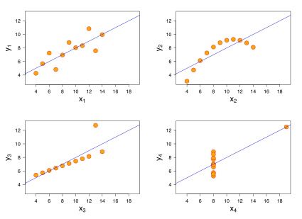
Why visualize? To see patterns
Wikipedia, “Anscombe’s Quartet”

Slide 6
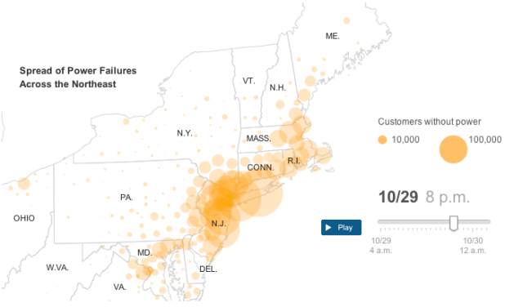
Why visualize? To tell a story

Slide 7
Impact of Data Visualization
More than numbers
11,356
Gun deaths in the US in 2018
Notes:
Other possibilities: “The Fallen of WWII”

Slide 8
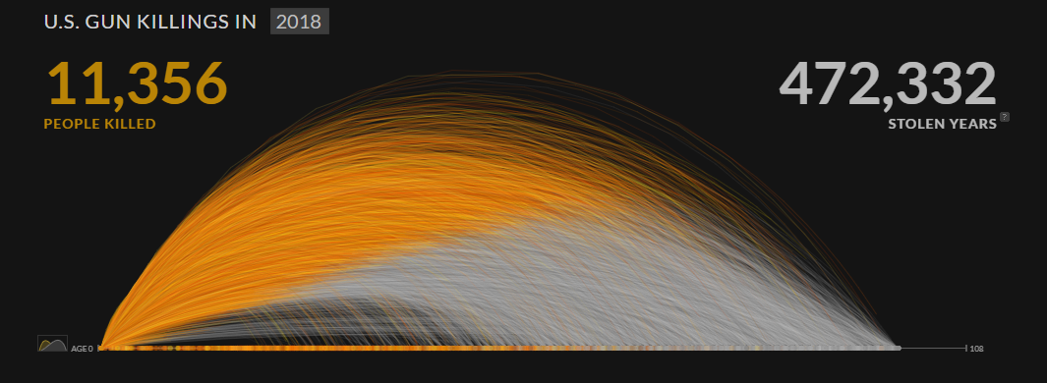
Impact of Data Visualization: Example
More than numbers
Periscopic.com, “US Gun Deaths”
Notes:
Other possibilities: “The Fallen of WWII”

Slide 9
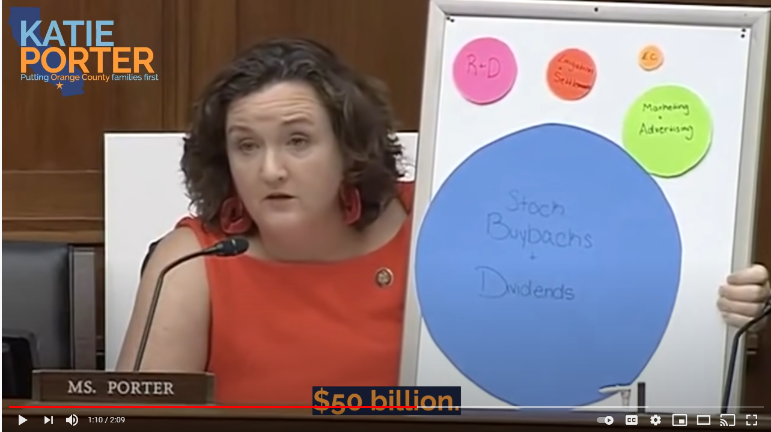
Power to Inform...
“Rep. Katie Porter Grills Big Pharma CEO About Industry's Lies”
Notes:
Provide scale and perspective
Example is US Representative Katie Porter showing the difference between R&D spending and other spending by pharmaceutical company, Abbvie.
Other possibilities: “Grains of Rice to Represent Jeff Bezos’ Wealth”

Slide 10
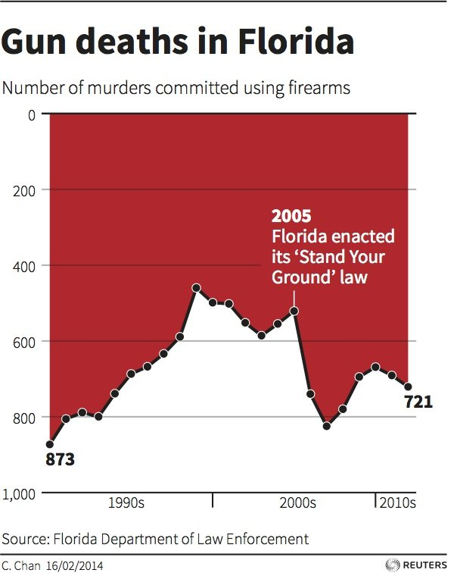
Power to Mislead
Ravi Parikh, “How to Lie with Data Visualization”

Slide 11
Power to Exagerate
Ravi Parikh, “How to Lie with Data Visualization”
Notes:
“Iraq’s bloody toll”
Rainbow blood flow visualizations - see slide later on - physicians using rainbow color scale made more wrong determinations

Slide 12
Why should I visualize my data?
Help analyze large quantities of data
Can embed in papers or articles to help explain your research
Use as a medium to deliver a message/narrative/story
Data-driven support for research, funding applications, etc.

Slide 13
When should I visualize my data?
Need to have:
A purpose: What question(s) are you trying to answer?
An audience: Boss? Coworkers? Funders? Yourself?
A plan/sketch: What types of charts would work best to answer your question(s)? What variables do you need to make those charts?
Time to clean the data, prep the data, sketch out a visualization, build the visualization, assess, modify

Slide 14
Visual principles/properties
Visualizing the Future Symposia
This project was made possible in part by the Institute of Museum and Library Services, RE-73-18-0059-18.
An IMLS funded National Forum on Data Visualization in Libraries

Slide 15
Gestalt Laws of Perceptual Organization
Humans naturally perceive objects as organized patterns and objects
known as Prägnanz
Gestalt: “more than the sum of its parts”
Early 20th century psychology
Principles of how we perceive patterns can be important to data visualization
6+ principles

Slide 16
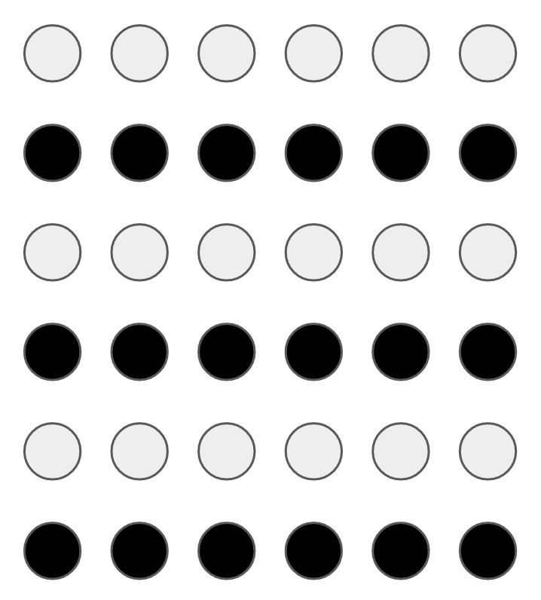
Law of Similarity
Our brains tend to make connections between elements with a similar design

Slide 17
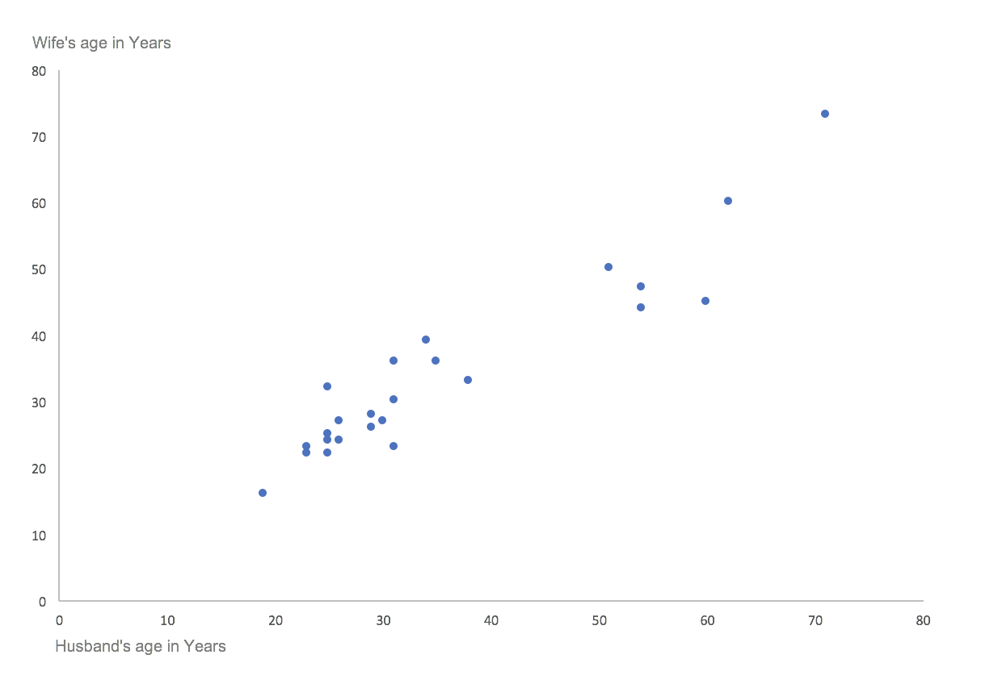
Law of Similarity Example 2.1
Our brains tend to make connections between elements with a similar design
Daydreaming Numbers, “Gestalt Laws Applied to Data Visualization”

Slide 18
Law of Similarity Example 2.2
Our brains tend to make connections between elements with a similar design
Daydreaming Numbers, “Gestalt Laws Applied to Data Visualization”

Slide 19
Law of Proximity
Elements that are closer together in a design are often linked in our minds

Slide 20
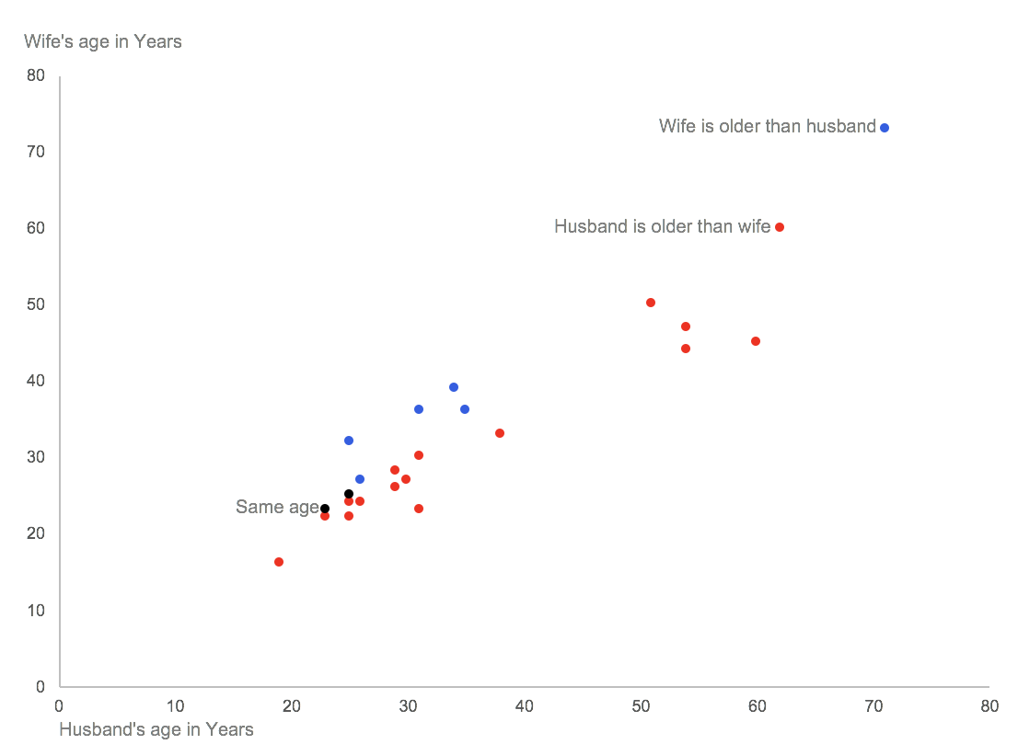
Law of Proximity Example 2
Elements that are closer together in a design are often linked in our minds

Slide 21
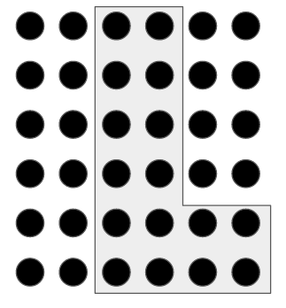
Law of Enclosure
Objects that appear to have a boundary around them are perceived as a group.

Slide 22
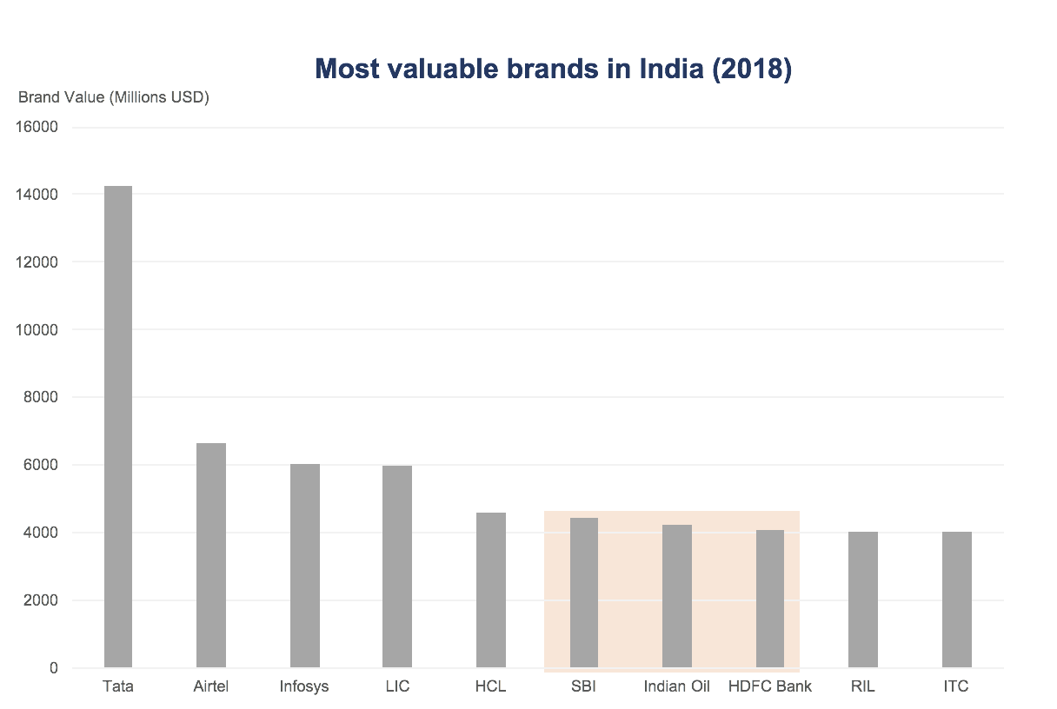
Law of Enclosure Example 2
Objects that appear to have a boundary around them are perceived as a group.

Slide 23
Law of Closure
Open structures are perceived as closed, complete, and regular whenever there is a way that they can be reasonably interpreted as such.

Slide 24
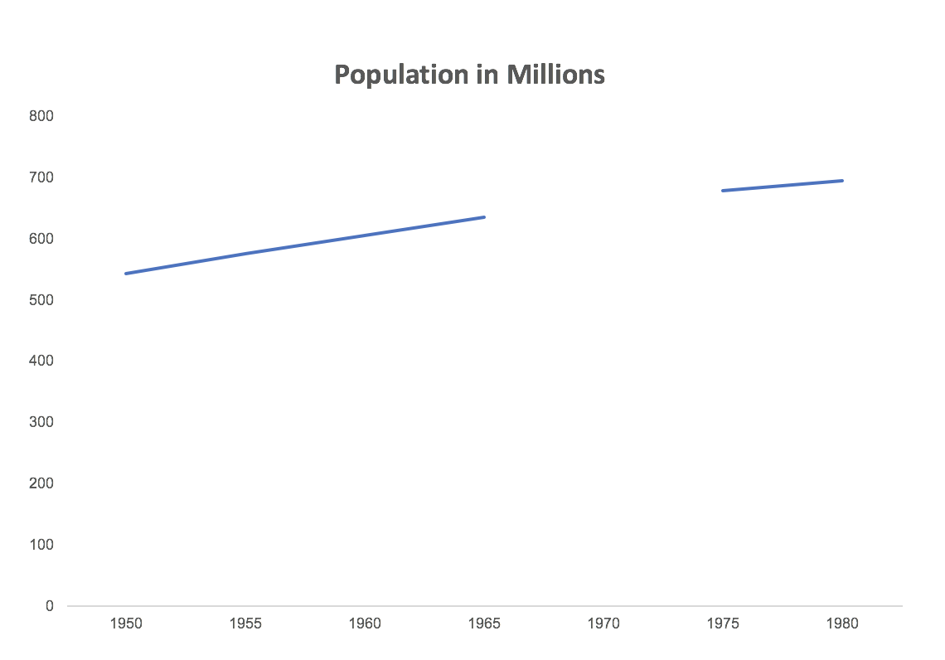
Law of Closure Example 2
Open structures are perceived as closed, complete, and regular whenever there is a way that they can be reasonably interpreted as such.

Slide 25
Law of Closure Example 2: Closed
Open structures are perceived as closed, complete, and regular whenever there is a way that they can be reasonably interpreted as such.

Slide 26
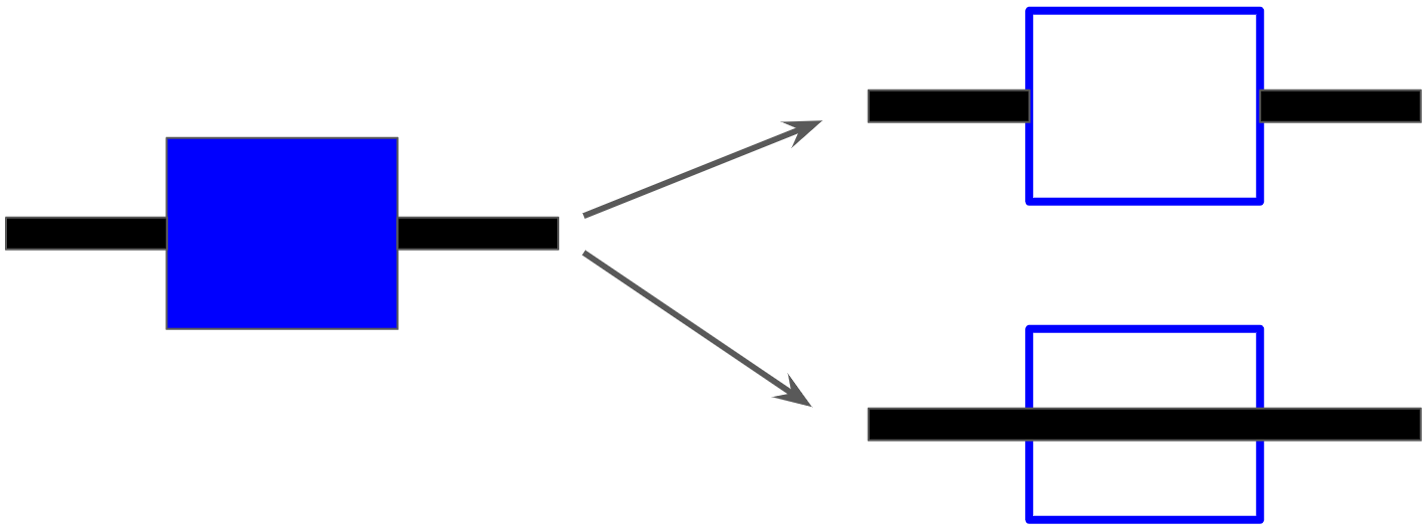
Law of Continuity
Objects that are aligned together or appear to be a continuation of one another are perceived as a group.

Slide 27
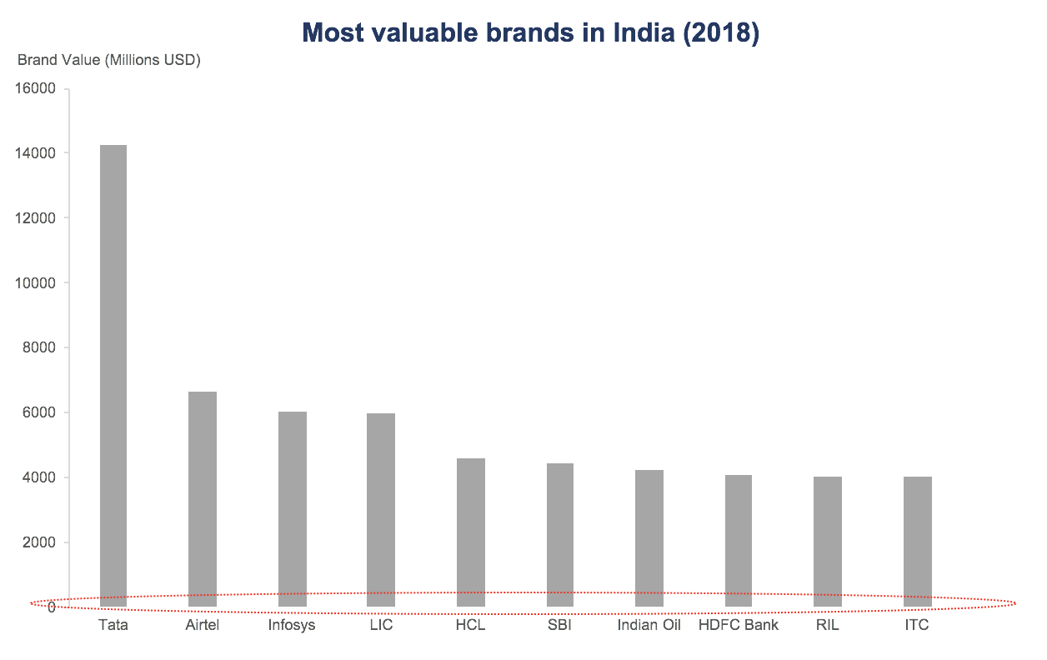
Law of Continuity Example 2
Objects that are aligned together or appear to be a continuation of one another are perceived as a group.

Slide 28
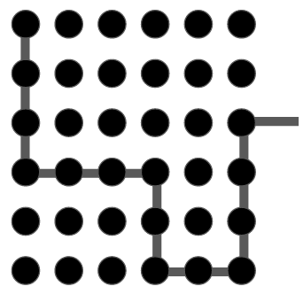
Law of Connection
Objects that are connected, usually by a line, are perceived as a group.

Slide 29
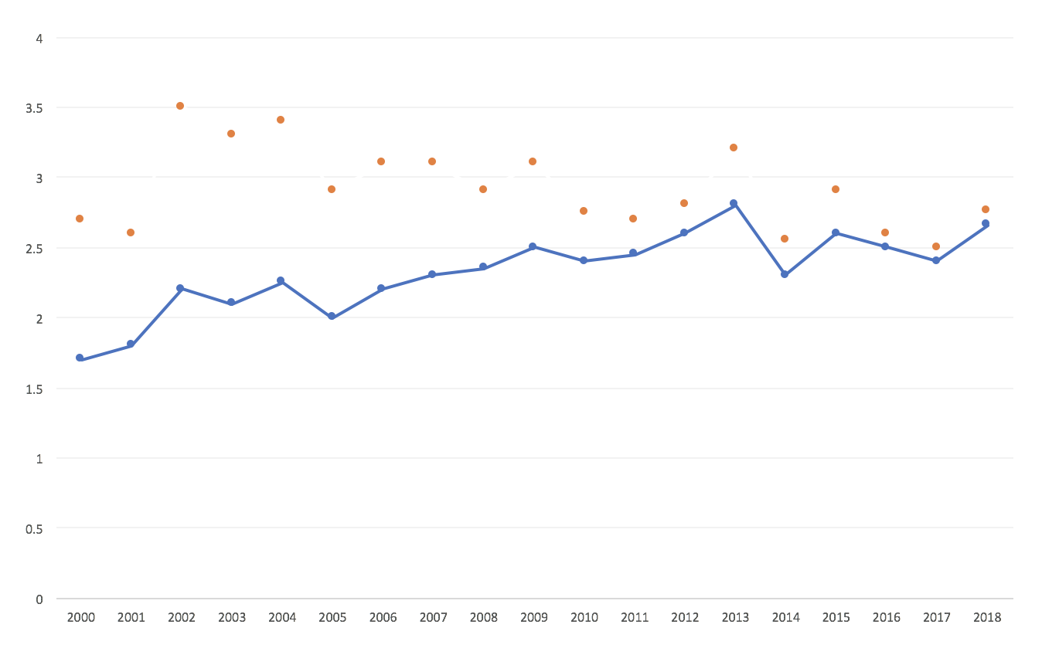
Law of Connection Example 2.1
Objects that are connected, usually by a line, are perceived as a group.

Slide 30
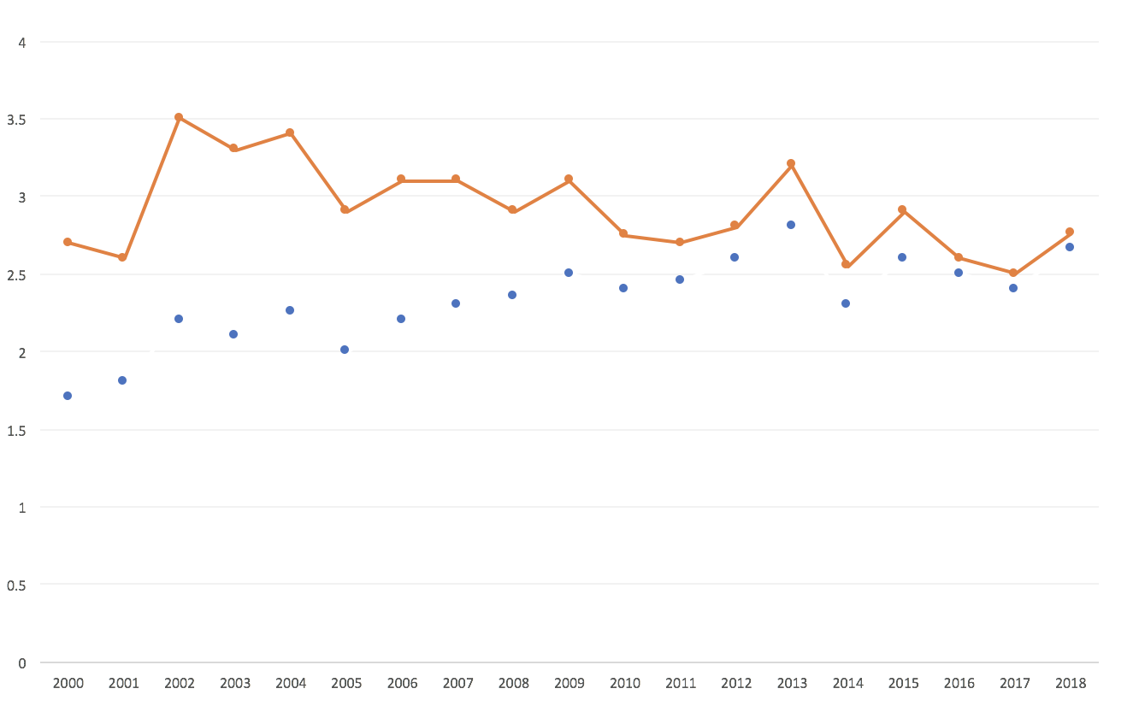
Law of Connection Example 2.2
Objects that are connected, usually by a line, are perceived as a group.

Slide 31
Preattentive Processing

Slide 32
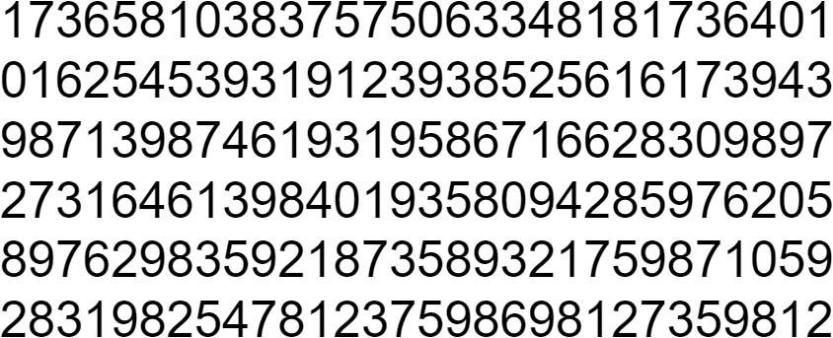
Count the 4s
Notes:
So, here’s a fun task. Go ahead and try to count the 4s in this block of numbers.
Poll audience: How many of you are about done? What is the right answer? How long did it take you?
The human brain is very powerful but sometimes it needs a hint about what info is most important so it doesn’t waste time evaluating every piece of info separately

Slide 33
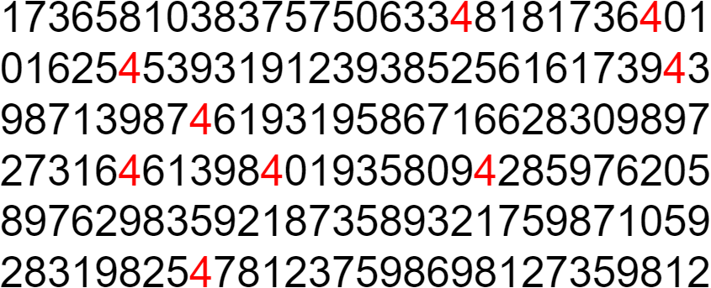
Count the 4s: Color
Notes:
How much easier is it to count the fours now that they have been highlighted. It’s almost instantaneous.
The phenomena that happens when we add visual information to highlight or differentiate stimuli is often called preattentive processing. It’s called preattentive because it happens in microseconds - before we can even form a thought about what we’re seeing

Slide 34
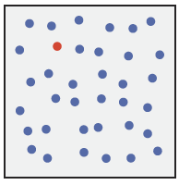
Pre-attentive Processing: Color
Healey, C. G., & Enns, J. T. (2012). Attention and visual memory in visualization and computer graphics. IEEE Transactions on Visualization and Computer Graphics, 18(7), 1170-1188. http://dx.doi.org.proxy.lib.duke.edu/10.1109/TVCG.2011.127
Notes:
Here’s another example of preattentive processing.
Again, uses change of color to allow us to preattentively process
When I ask you to find the red circle, it’s almost impossible not to see it.

Slide 35
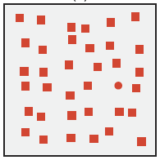
Pre-attentive Processing: Shape
Healey, C. G., & Enns, J. T. (2012). Attention and visual memory in visualization and computer graphics. IEEE Transactions on Visualization and Computer Graphics, 18(7), 1170-1188. http://dx.doi.org.proxy.lib.duke.edu/10.1109/TVCG.2011.127
Notes:
Again, when I ask you to look for the red circle, this task is quite easy because shape has been manipulated in a way that is also preattentive

Slide 36
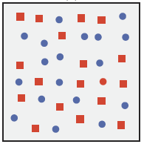
Pre-attentive Processing: Combined
Healey, C. G., & Enns, J. T. (2012). Attention and visual memory in visualization and computer graphics. IEEE Transactions on Visualization and Computer Graphics, 18(7), 1170-1188. http://dx.doi.org.proxy.lib.duke.edu/10.1109/TVCG.2011.127
Notes:
But if you try to find the red circle amongst this set of distractors, the process becomes attentive or serial. You essentially have to evaluate each single icon separately to see if it meets the criteria: both red and circle
The power of preattentive processing is diminished or entirely eliminated when you have two conflicting styles of visual representation

Slide 37
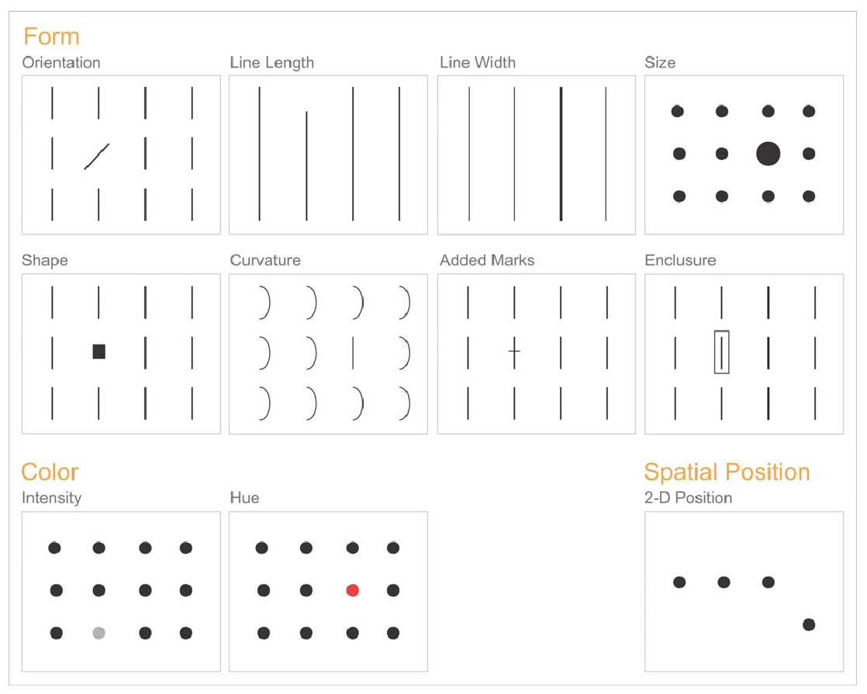
Pre-attentive attributes for visualization
Also see work of Colin Ware and Christopher Healey
Stephen Few, “Tapping the Power of Visual Perception”
Notes:
Here are the different attributes that have been found to be preattentive when used in isolation.
We’ve already talked about hue and shape, but there are also ways to manipulate orientation, width, etc.

Slide 38
Key parts of a data visualization
Visualizing the Future Symposia
This project was made possible in part by the Institute of Museum and Library Services, RE-73-18-0059-18.
An IMLS funded National Forum on Data Visualization in Libraries

Slide 39
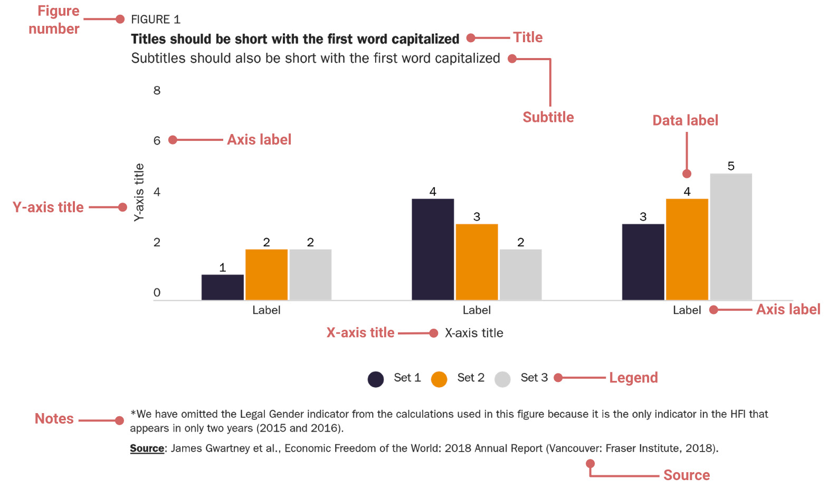
Components of a Visualization
Source: Abrigo, L.A. & Schneider, G.S. (2018). Data visualization guidelines. The Cato Institute. https://github.com/glosophy/CatoDataVizGuidelines
Notes:
A visualization is made up of several key components: content, title, axes, and the source of the data

Slide 40
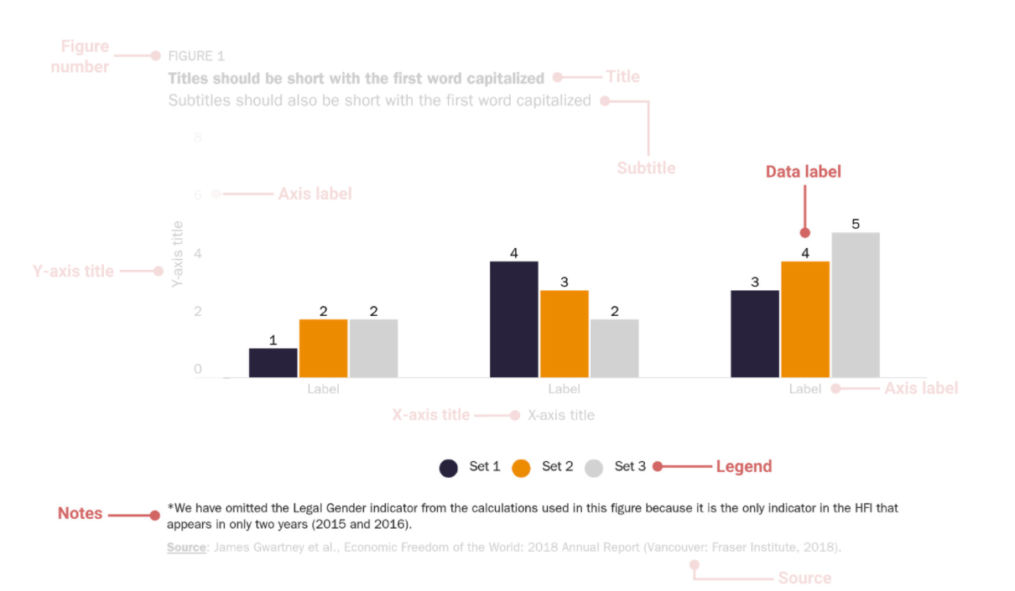
Chart Content
Source: Abrigo, L.A. & Schneider, G.S. (2018). Data visualization guidelines. The Cato Institute. https://github.com/glosophy/CatoDataVizGuidelines
Notes:
The main part of your visualization the is chart content

Slide 41
Many options for representing data
Visualization Analysis and Design. Tamara Munzner, with illustrations by Eamonn Maguire. A K Peters Visualization Series, CRC Press, 2014. Figure used under a CC-BY 4.0 license.
Notes:
Once you have chosen which chart you want to use there are so many options to represent the data as lines, shapes, colors, size, etc.
This table orders the visual channels from most to least effective for both quantitative/ordered data and categorical data.
Image from “Visualization Analysis and Design, PDF Diagrams for Download”

Slide 42
Caution when using area as your visual encoding
Size increasing exponentially
Correct increase in area
1
2
3
1
2
3
Notes:
When shapes change size we compare areas, so the data point should map to area and not just the length of one side or the diameter.

Slide 43
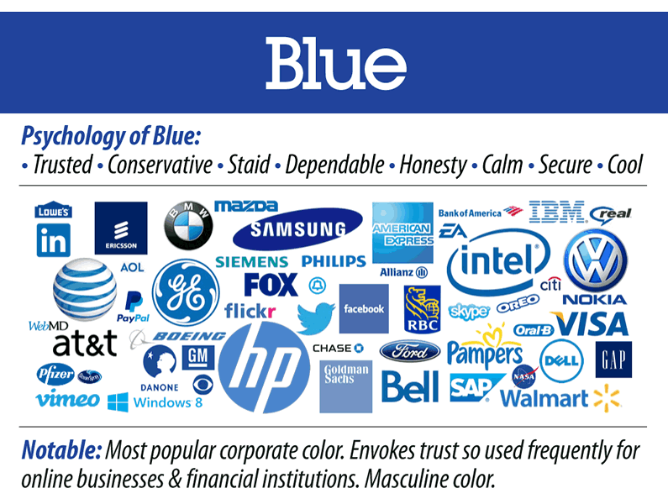
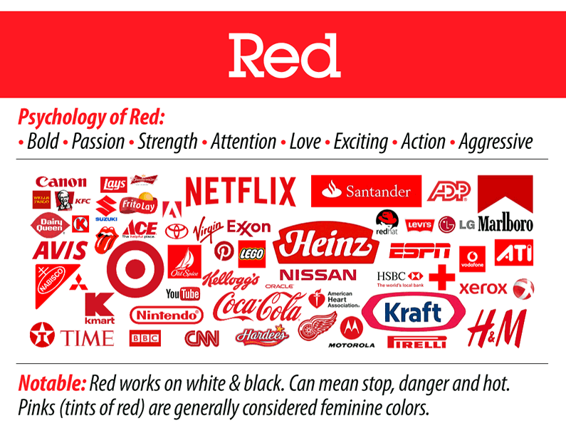
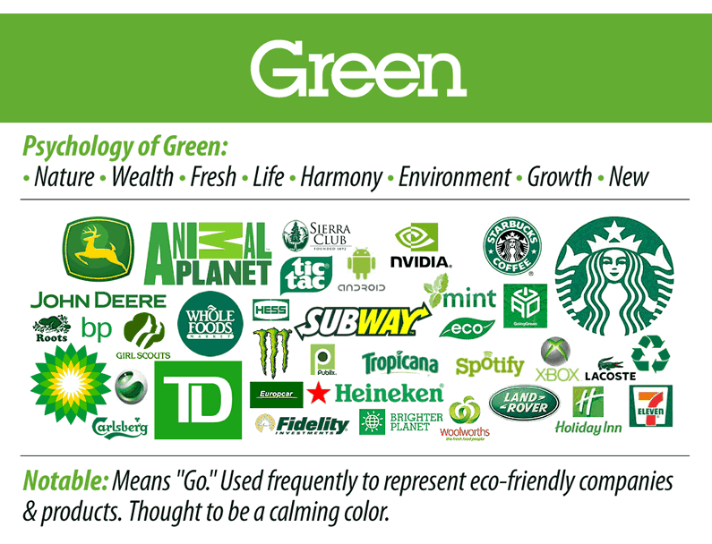
Meaning of color
Images from The Logo Factory, “Choosing Great Logo Colors Help Bran Selection”
Notes:
Keep in mind: colors have different meanings- can change across cultures. One can see this often in company logos.
Red: passion, love, blood, excitement – seen in a lot of logos for food and entertainment (ex. Coca Cola, Dairy Queen, Netflix, CNN)
Blue: trust, calm – seen in communication, healthcare, and bank logos (ex. Visa, IBM, Bell)
Green: growth – see in nature related and bank logos (TD, John Deere, Land Rover)

Slide 44
Color inspiration
From an image
Use an image color picker to find out the hex code or RGB code
Copy pre-tested color gradients
ColorBrewer 2.0
CartoColor
Use a single color or group of colors as inspiration to create your palette
Chroma.js Color Palette Helper
Colorpicker for data
And many others!
Notes:
Source: Datawrapper, “Your Friendly Guide to Colors in Data Visualization”

Slide 45
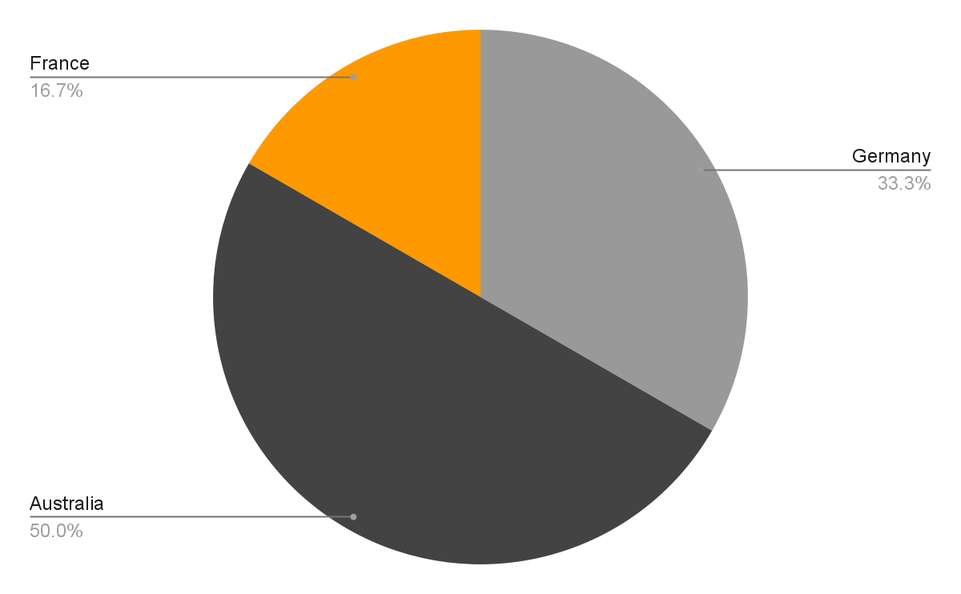
Using color to highlight

Slide 46
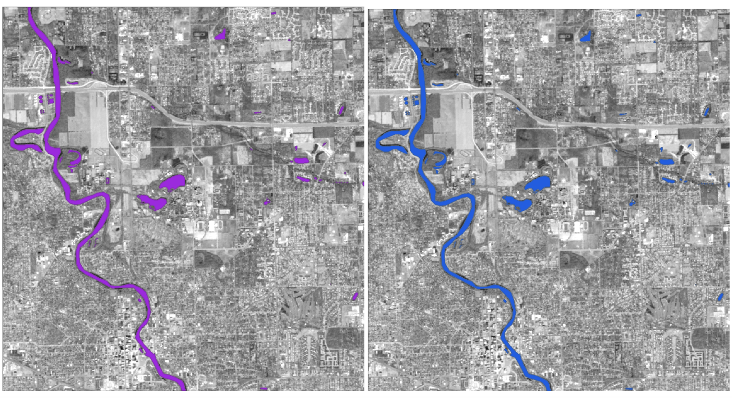
Use predefined color meanings
Notes:
For water bodies, use blue

Slide 47
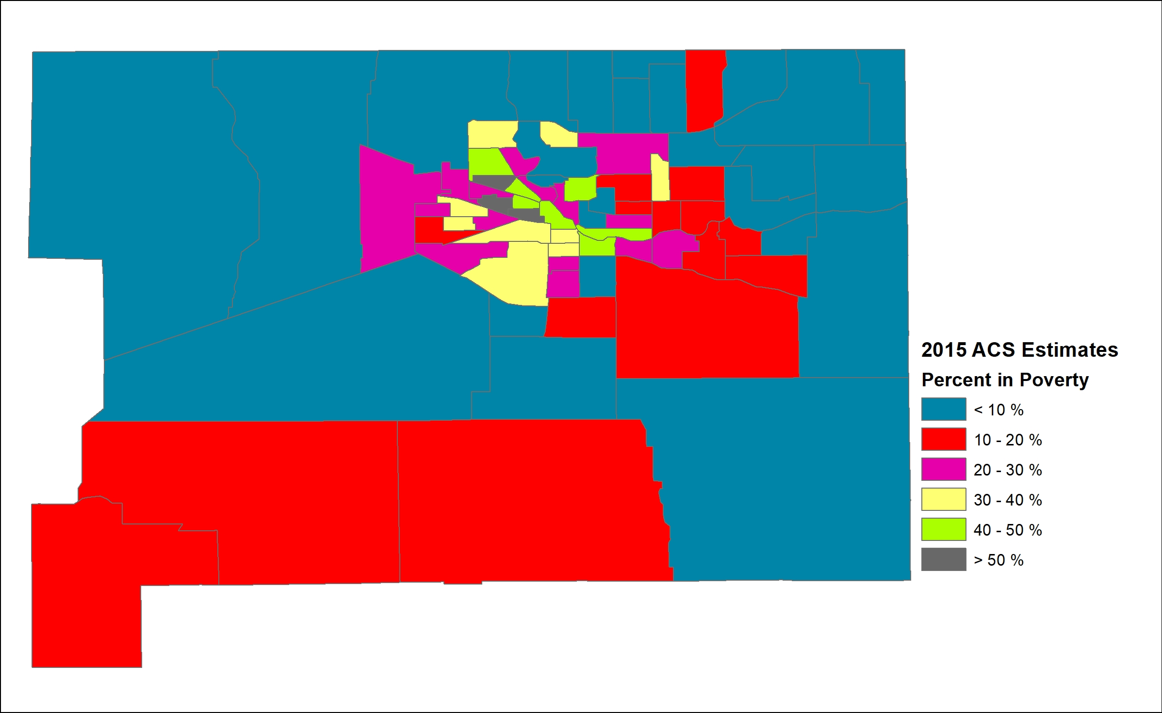
Map of population below poverty line in Saint Joseph County, IN
This is a map showing the percentage of the population under the poverty line in Saint Joseph County, IN. Do the colors make immediate sense to the viewer? Is it easy to see what areas are higher or lower than others?

Slide 48
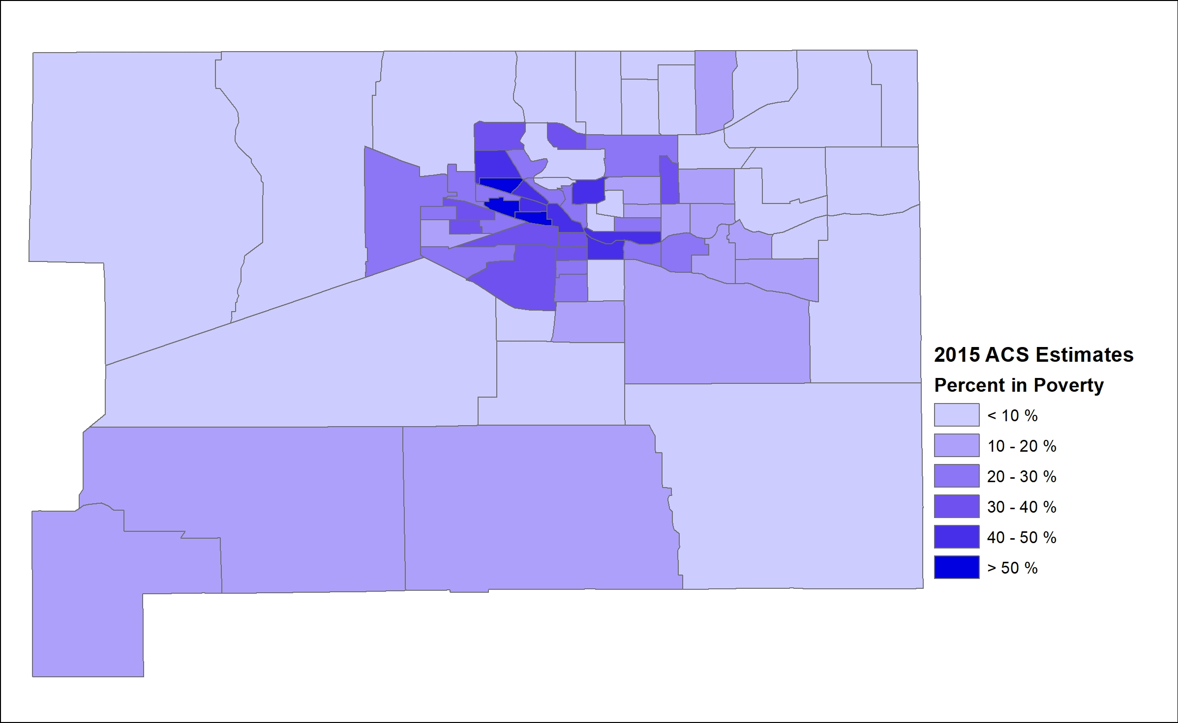
Improved map of population below poverty line in Saint Joseph County, IN
This is a better way of showing the same information. Using a gradually darkening or lightening color makes numerical values immediately clear to the viewer and we can easily pick out patterns.

Slide 49
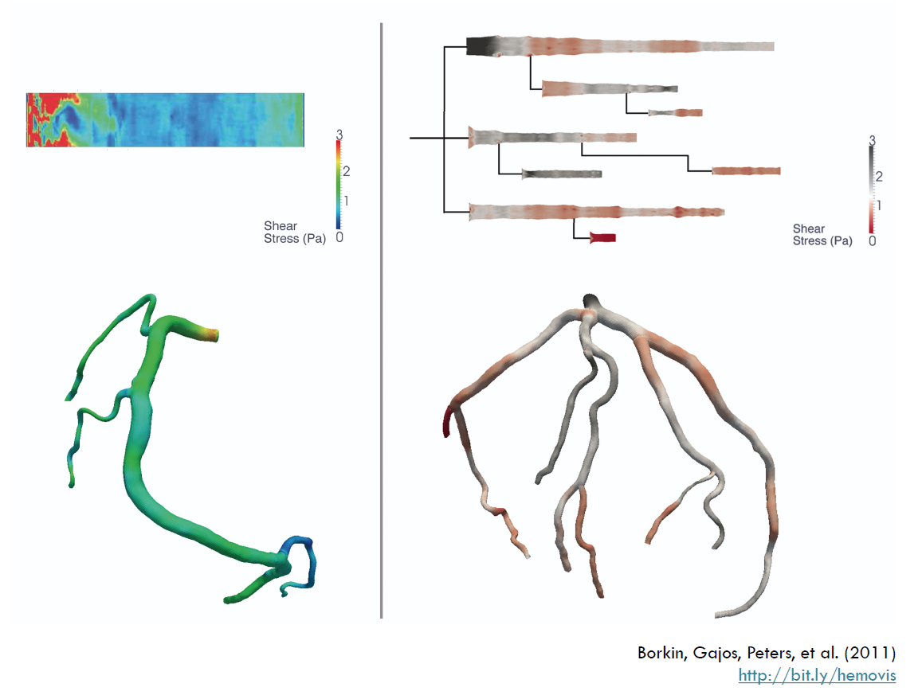
Importance of color choices
A
B
Borkin, Gajos, Peters, et al. (2011), “Evaluation of Artery Visualizations for Heart Disease Diagnosis,” https://vcg.seas.harvard.edu/publications/evaluation-of-artery-visualizations-for-heart-disease-diagnosis
Notes:
Example of importance of color and chart type
Change from a three dimensional visualization with a rainbow scale to a two-dimensional visualization with a divergent color scale
The final visualization should match what the data is saying
Evaluation of artery visualizations for Heart Disease Diagnosis – low endothelial sheer stress as an indicator
Where is it easiest to identify which regions of the arteries correspond with 0 sheer stress?
“We show statistically significant results demonstrating that our 2D visualizations are more accurate and efficient than 3D representations, and that a perceptually appropriate color map leads to fewer diagnostic mistakes than a rainbow color map.” ~Borkin, Gajos, Peters, et al.

Slide 50
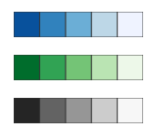
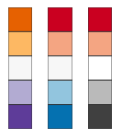
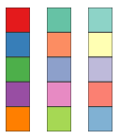
Color scales
Sequential (dark to light or light to dark)
Quantitative data or ordered qualitative data
Binned (split into brackets) or continuous. Ordered qualitative data should only used binned scales.
Single or multiple hues
Diverging (dark in 1 hue to light to dark in a different hue)
Quantitative data or ordered qualitative data
Binned (split into brackets) or continuous. Ordered qualitative data should only used binned scales.
Use if there is a meaningful middle point
Categorical
Qualitative data
Give hues different lightnesses so that they work in grayscale as well
Color scales from ColorBrewer 2.0
Notes:
Multiple huse can increase color contrast, making it easier to distinguish
Diverging color scales are less intuitive than sequential color scales
“Examples of meaningful middle point:
zero, e.g., positive and negative economic growth
50%, e.g., the vote between two choices
the average or median, e.g., age below and above the median age
an agreed threshold, e.g., income levels below and above the poverty line
a target, e.g., revenue below and above the quarterly target”
Sources: Lisa Charlotte Muth. “Which color scale to use when visualizing data.” Datawrapper Blog. Accessed: September 21, 2021
Lisa Charlotte Muth. “When to use sequential and when to use diverging color scales.” Datawrapper Blog. Accessed: September 21, 2021

Slide 51
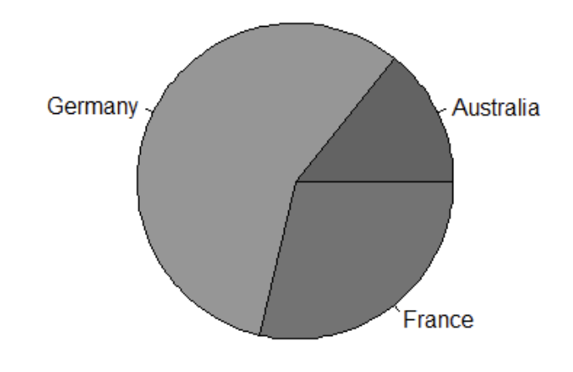
Color
Extra tips
Less is more when it comes to color
Ensure enough contrast between your colors
Know where your image will appear
Will it contrast enough with the background
Will the chart be printed in grayscale
Notes:
This is an example of how something might look printed in greyscale that doesn’t have enough contrast between the sections
Germany’s grey is #969696
Australia’s grey is #636363
France’s grey is #737373
The greatest contrast in color is between Germany and Australia with a contrast of 2:03:1. Recommended contrast for graphics is 3:1.

Slide 52
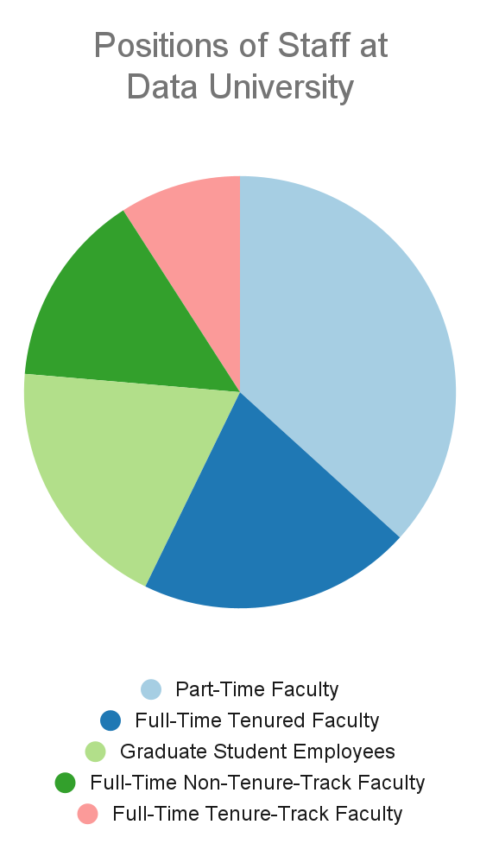
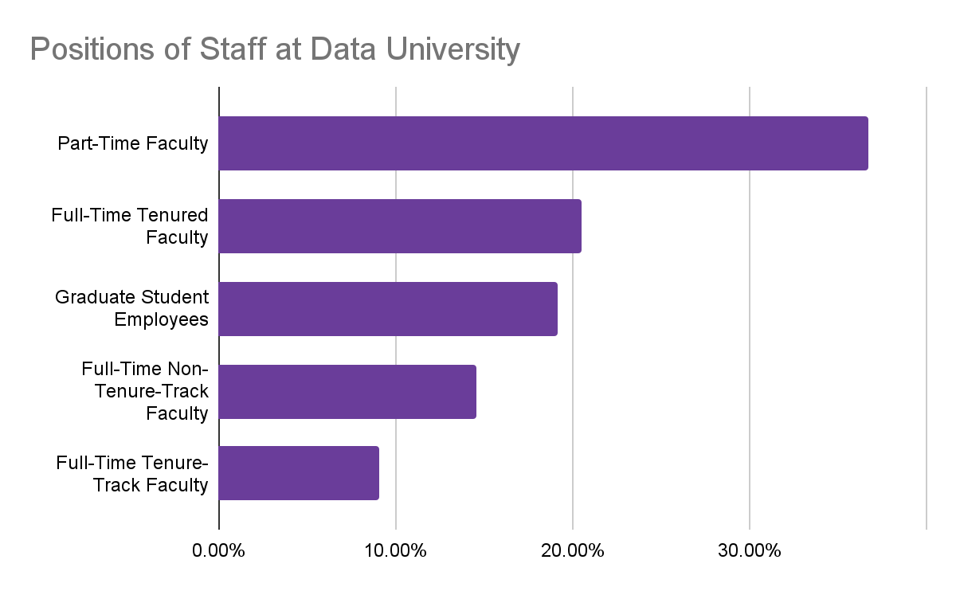
Put content in order
Position | Percent of Employees
Part-Time Faculty | 36.73%
Full-Time Tenured Faculty | 20.49%
Graduate Student Employees | 19.13%
Full-Time Non-Tenure-Track Faculty | 14.56%
Full-Time Tenure-Track Faculty | 9.09%

Slide 53
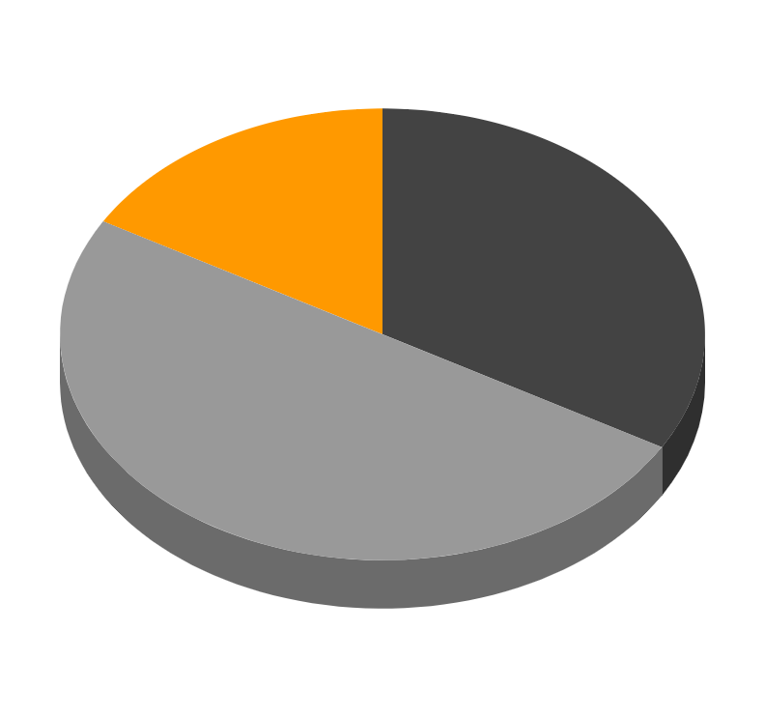
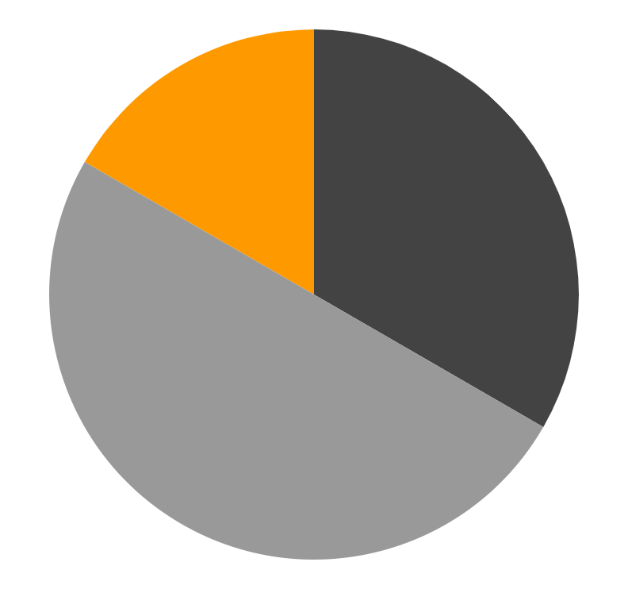
Only use 3D charts for 3 dimensional data
3D Distortion
Better

Slide 54
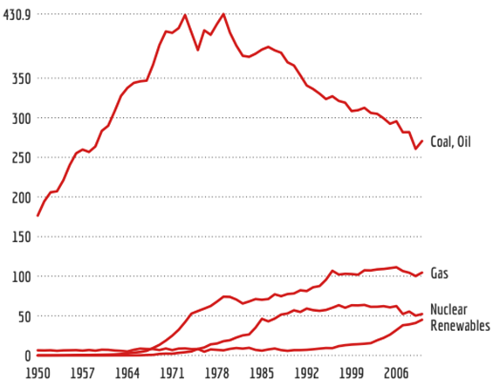
Labels
Label data directly, legends are not (usually) necessary
Use annotation to highlight key points in the chart
Keep text horizontal
Gregor Aisch, “Doing the Line Charts Right”

Slide 55
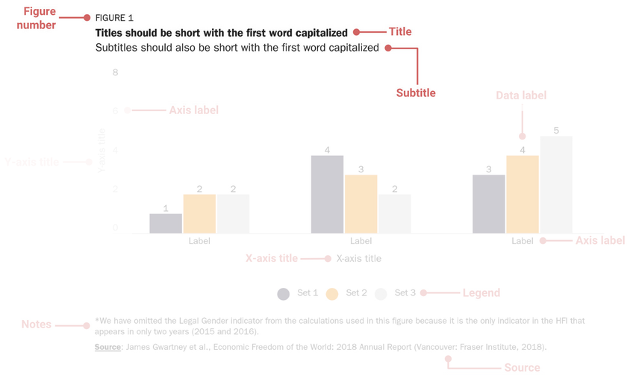
Title: Example
Source: Abrigo, L.A. & Schneider, G.S. (2018). Data visualization guidelines. The Cato Institute. https://github.com/glosophy/CatoDataVizGuidelines

Slide 56
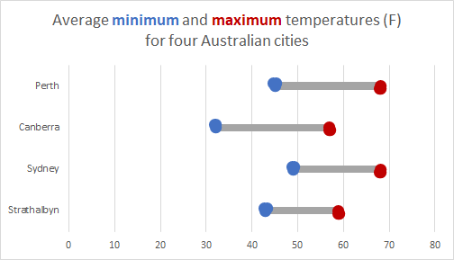
Title
Titles, axis labels, captions, data source and other annotations provide context and improve readability.
Always include a title of the data visualization
Should be descriptive and convey the main message of the chart
Can use color to match variable name in the title with the chart content

Slide 57
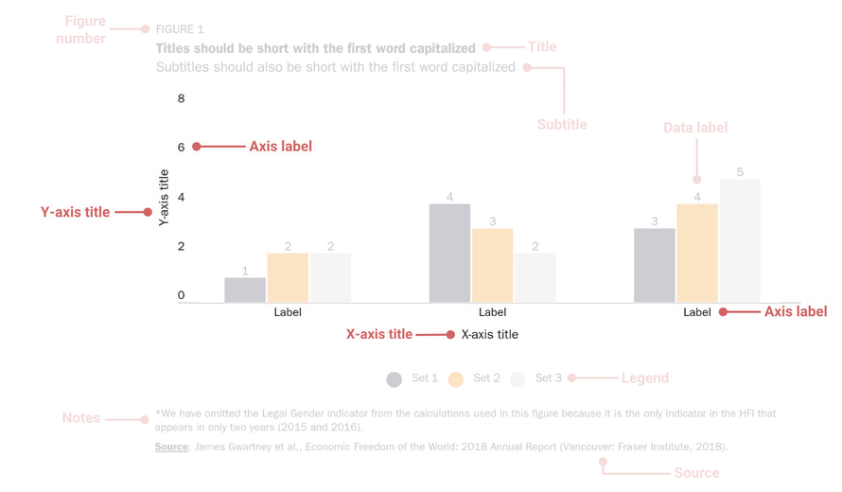
Axes: Example
Source: Abrigo, L.A. & Schneider, G.S. (2018). Data visualization guidelines. The Cato Institute. https://github.com/glosophy/CatoDataVizGuidelines

Slide 58
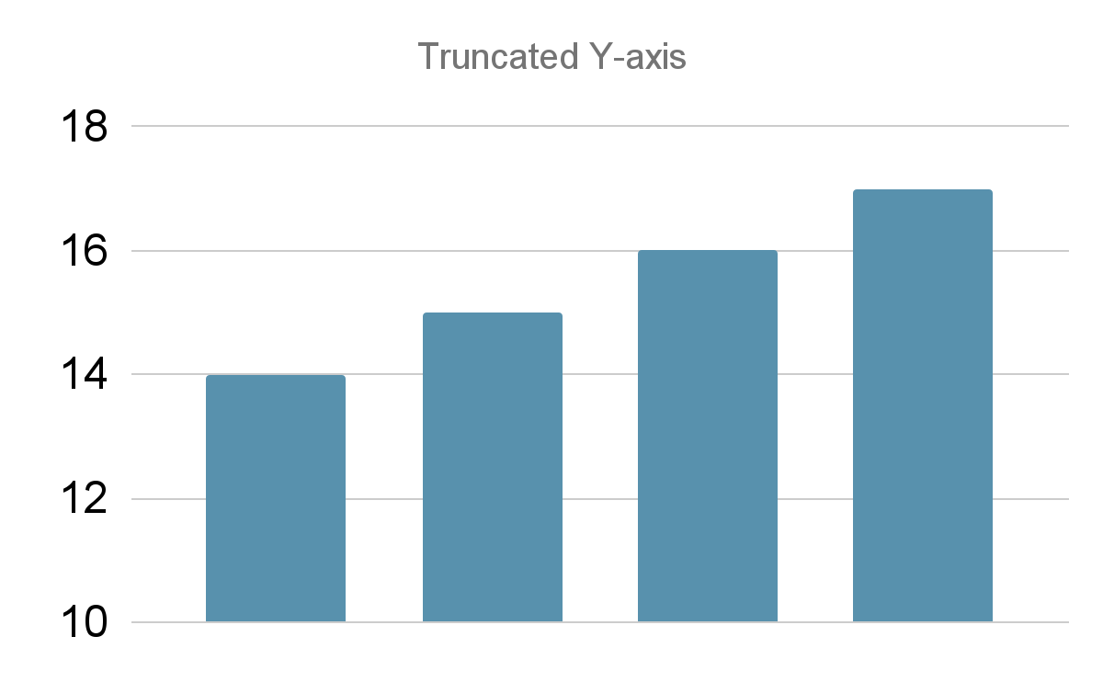
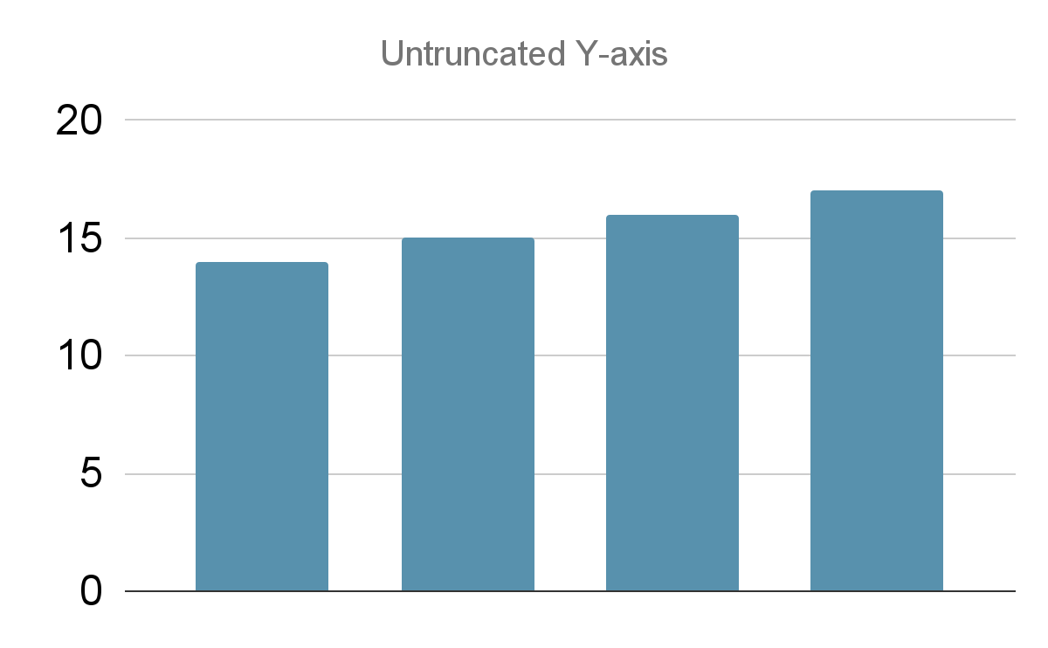
Axes
Axes also provide scale (start at 0 to avoid distortion, with some exceptions)
Highlight main variables (and units of measurement)
Consider adding gridlines - they can be useful reference guides
Be cautious when using dual y-axes because the magnitude can change for each metric and imply correlation and causation when there is none (ex. Spurious Correlations)
Notes:
Just be careful that the gridlines don’t add extra clutter

Slide 59
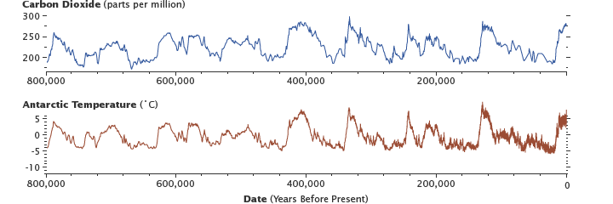
Be consistent when using multiple charts for comparison
Use consistent formatting and chart elements when including two or more visualizations for comparison
Carry over any representative colors between groups
Make sure axes using the same measurement that are beside each other are using the same range
Image by Bvelevski used under a CC-BY-SA 4.0. Source: https://commons.wikimedia.org/wiki/File:Epica_CO2_temperature.png
Notes:
Image by Bvelevski used under a CC-BY-SA 4.0. Source: https://commons.wikimedia.org/wiki/File:Epica_CO2_temperature.png

Slide 60
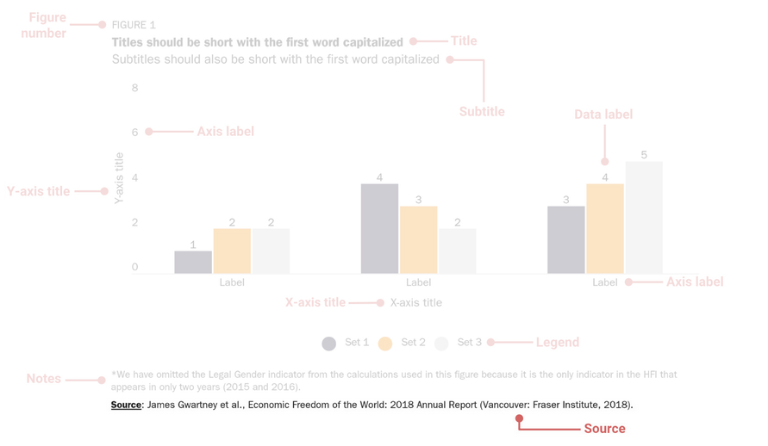
Source / Data Citation
Source: Abrigo, L.A. & Schneider, G.S. (2018). Data visualization guidelines. The Cato Institute. https://github.com/glosophy/CatoDataVizGuidelines

Slide 61
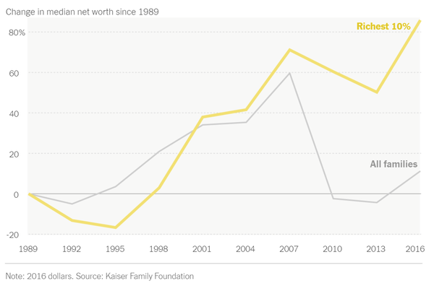
Data citation
If you are using someone else’s data, cite it!
If you published the full dataset, cite it!
Helps readers find the original data source
Increases the legitimacy of your chart
Copy the citation suggested where you got the
data or use your preferred citation style.
Primary components:
Author/ Creator (Individual, group, or organization)
Title
Year of Publication
Publisher (often the repository where the data is housed)
Version or edition
Access Information (URL, DOI, or another persistent identifier)
Michael Gonchar, “Teach About Inequality With These 28 New York Times Graphs”
General format:
Author (Year). Title with version. Publisher. Access information.
Notes:
Note: including citation to data source is important to an ethical approach to labor in data visualization and is also emphasized throughout the Ethics in Data Visualization module.

Slide 62
Types of data visualizations and examples
Visualizing the Future Symposia
This project was made possible in part by the Institute of Museum and Library Services, RE-73-18-0059-18.
An IMLS funded National Forum on Data Visualization in Libraries
Notes:
Possibly useful: Duke: Intro to Data Vis Spring 2018

Slide 63
Types of charts and visualizations
Basic charts and graphs
Bar
Pie
Line
Scatter
Box plot
Maps (briefly)
Notes:
The next few slides will review bar, pie, line, and scatter charts and box plots. While this presentation will touch on mapping, there is an entire field (cartography and GIS) devoted to this.
Optional - add dashboard and define: Although this will not be covered in this presentation, for reference, when someone talks about a dashboard they are referring to an interactive tool composed of charts and filters that allows the user to explore the data.

Slide 64
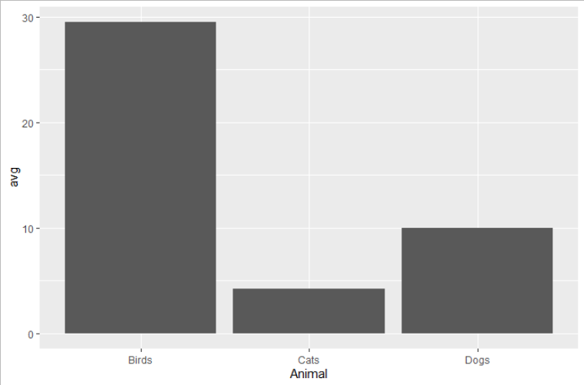
Bar chart
Presents categorical (nominal or ordinal) data with rectangular bars with heights proportional to the values that they represent.
Variations: stacked bar chart, grouped bar chart
Notes:
Bar charts are effective at communicating data because we tend to be good at comparing lengths. They present categorical data with rectangular bars with heights proportional to the values that they represent. Some variations include stacked bar charts, where different parts of a category are stacked on top or side by side in a single bar, or grouped bar charts, where different parts of a category are represented in side by side but separate bars.

Slide 65
Best practices for bar charts
Bar color:
Simple color scheme - all one color except for strategic highlights
Axis labels:
All text horizontal
Bar order:
Bars sorted by length or another natural criterion (e.g., age groups)
Axis limits:
Axis starts at 0, ends at a natural point, and has helpful but limited breaks
Urban Institute Data Visualization Style Guide
Notes:
Some best practices for a bar chart include having horizontal axis labels so they are easier to read, bars sorted by length or some other logical order, a simple color scheme that highlights certain bars strategically, and an axis that starts at zero and ends at a natural point.
Also: use bars for data categories that are discrete: for variables like country or university that are categorical, it is in appropriate to use a chart type that is designed for continuous data, like a line chart which uses a line to indicate continuity from one point to the next. (Zacks, J., Tversky, B. Bars and lines: A study of graphic communication. Mem Cogn 27, 1073–1079 (1999). https://doi.org/10.3758/BF03201236)
Datawrapper, “Why our column and bar charts start at zero (or below)”
Datawrapper, “What to consider when creating stacked column charts”
“Data Design Standards: Bar Charts”
“Data Design Standards: Stacked Bar Charts”
Urban Institute Data Visualization Style Guide
Curved Discussion, “When can a line be a bar?”
“Cato Data Viz Guidelines”
Data-to-viz, “A collection of graphic pitfalls”
IBM Design Language, “Charts”
Graphic from Urban Institute Data Visualization Style Guide; shared with the same license as the original.

Slide 66
Regarding stacked and grouped bar charts
Small multiples (preferred):
Each group has its own chart, but they’re organized well and use a common axis so that trends can be compared. Note: if data are really discrete categories, use bars instead of area charts.
Moving baseline:
Segments in inner series are hard to compare
Visual confusion:
Bars within one series are now spread out; small changes will be hard to follow
Urban Institute Data Visualization Style Guide
Notes:
Stacked bar charts, covered a couple of slides ago, can be useful but make it difficult to compare categories in the middle. Grouped bar charts can be confusing when bars within a series are spread out. Small multiples are an effective way to represent categorical data because they use a common axis that allows trends to be compared.
Also: use bars for data categories that are discrete: for variables like country or university that are categorical, it is in appropriate to use a chart type that is designed for continuous data, like a line chart which uses a line to indicate continuity from one point to the next. (Zacks, J., Tversky, B. Bars and lines: A study of graphic communication. Mem Cogn 27, 1073–1079 (1999). https://doi.org/10.3758/BF03201236)
Datawrapper, “Why our column and bar charts start at zero (or below)”
Datawrapper, “What to consider when creating stacked column charts”
“Data Design Standards: Bar Charts”
“Data Design Standards: Stacked Bar Charts”
Urban Institute Data Visualization Style Guide
Curved Discussion, “When can a line be a bar?”
“Cato Data Viz Guidelines”
Data-to-viz, “A collection of graphic pitfalls”
IBM Design Language, “Charts”
Graphic from Urban Institute Data Visualization Style Guide; shared with the same license as the original.

Slide 67
Pie chart
A circle divided into slices to illustrate numerical proportion
Categorical data
Criticized because can be hard to compare proportions
Notes:
Pie charts are another very popular chart type. A pie chart is a circle that is divided into slides to illustrate numerical proportions. While popular, they are often criticized because it can be difficult to compare proportions.

Slide 68
Best practices for pie charts
Number of wedges:
Only a few data points in the chart (five at most)
Type of data:
Data represent a “part-to-whole” relationship
Size of wedges:
Wedges generally quite different from each other, small differences don’t matter
Wedge order:
Wedges sorted by size or another natural criterion (e.g., positivity) starting at “12:00”
Wedge labels:
Wedges labeled directly when possible
Datawrapper, “What to Consider When Creating a Pie Chart”
Notes:
Only use if you have a limited number of data points (five at most)
Not an effective chart option when the data points are very similar to each other
Makes most sense if the data are parts of a whole (should always total 100%)
Sort the pie wedges in a natural ordering (often biggest to smallest)
Resources
Datawrapper, “Why our column and bar charts start at zero (or below)”
Datawrapper, “What to consider when creating stacked column charts”
“Data Design Standards: Bar Charts”
“Data Design Standards: Stacked Bar Charts”
Urban Institute Data Visualization Style Guide
Curved Discussion, “When can a line be a bar?”
“Cato Data Viz Guidelines”
Data-to-viz, “A collection of graphic pitfalls”
IBM Design Language, “Charts”
Graphic from Urban Institute Data Visualization Style Guide; shared with the same license as the original.

Slide 69
Line chart
Data points called 'markers' connected by straight line segments
Both continuous
Usually the line indicates a continuous pattern
i.e., time or temperature
Variations: area chart, stacked area chart
Notes:
Line charts include data points called markers that are connected by straight line segments. They work best when representing continuous data, such as time or temperature. Some variations include area charts or stacked area charts, where the space under the line(s) are filled in.
Vis4, “Doing the Line Charts Right”

Slide 70
Best practices for line charts
Legend:
Lines labeled directly when possible
Line color:
Limited number of colors and line styles. If many lines, use grey for most.
Numerical axis:
X-axis variable is a number (e.g., years) and not a set of categories (e.g., countries).
Complete axis:
X-axis displays the numbers correctly in a full range, instead of having gaps
Urban Institute Data Visualization Style Guide
Notes:
Label lines directly when possible. It can be difficult to connect lines up to legend entries based only on color and style.
Limit the number of different colors and line styles used in a single chart.
If data are distributed unevenly over the time period, add circles to the line to be explicit about where there are data points.
Be cautious with stacked area charts. It is difficult to interpret the changes to inner categories against a moving baseline. A simple line chart is often easier to read.
Also: don’t use lines to connect discrete categories. For example, for variables like country or university that are categorical, it is in appropriate to use a chart type that is designed for continuous data, like a line chart which uses a line to indicate continuity from one point to the next. (Zacks, J., Tversky, B. Bars and lines: A study of graphic communication. Mem Cogn 27, 1073–1079 (1999). https://doi.org/10.3758/BF03201236)
“Data Visualization Standards: Line Graph”
Urban Institute Data Visualization Style Guide
“Cato Data Viz Guidelines”
Data-to-viz, “A collection of graphic pitfalls”
IBM Design Language, “Charts”
Graphic from Urban Institute Data Visualization Style Guide; shared with the same license as the original.

Slide 71
Watch for text axes in Excel
Line chart
Scatter plot
AAUP, “Trends in Instructional Staff Employment Status, 1975-2011”
Notes:
In Excel, if you use the “line chart” chart type, you may get a categorical or text axis for the x axis, which spaces data out evenly. If you have gaps in your data for that axis - for example, if you don’t have data for every year - the chart will distort the rate of change in the data. The chart on the right was created in Excel, but it uses the “scatter plot” chart type instead, with the variation that adds a line between the points. Note how having both lines and points really emphasizes where the data points are and where there are gaps.
(The data here come from a report on Trends in Instructional Staff Employment Status in degree-granting institutions in the US.)

Slide 72
Scatter plot
Bivariate plot of two continuous variables
Can be many y values for each x
Trend-lines can show a pattern but do not connect all the points
Variations: bubble chart
Notes:
Scatter plots are bivariate plots of two continuous variables. There can be many y values for each x value. You may see them with a trend line that doesn’t connect the points but tries to communicate a general trend. Some types of bubble charts are a variation of scatter plots.

Slide 73
Best practices for scatter plots
Overplotting:
Transparency shows where points overlap
Selective labeling:
Points labeled directly, but only points of interest
Bubble size:
Data maps to bubble area, not radius or diameter
Explanatory elements:
Additional elements (reference lines, annotations) help explain trends
Point color:
Limited number of colors
Datawrapper, “Examples of Datawrapper Scatter Plots”
Notes:
Beware of overplotting (dots that are stacked on top of each other); use transparency or aggregation (e.g., spatial histogram, binned scatterplot) to make it clear how much data you have
Do not allow points to fall directly on axis; include some visual padding or change your axis limits so the points fall completely inside the chart and are fully visible against the background
If using size to represent a numerical variable, make sure the chart maps the number to the area of the bubble instead of the diameter or radius
If using color to represent either numerical or categorical data, review guidelines on appropriate use of color in visualizations.
“Data Design Standards: Scatter Plot”
“Data Design Standards: Bubble Chart”
“Data Design Standards: Bar Charts”
“Data Design Standards: Stacked Bar Charts”
Urban Institute Data Visualization Style Guide
Curved Discussion, “When can a line be a bar?”
“Cato Data Viz Guidelines”
Data-to-viz, “A collection of graphic pitfalls”
IBM Design Language, “Charts”

Slide 74
Box plot
Method for displaying the variability in measure between groups
One categorical, one continuous
Notes:
Box plots show the variability in measure between groups.

Slide 75
Best practices for box plots
Box order:
Bars sorted by median or another natural criterion
Outliers:
Outliers retained or absence explained
Documentation:
Chart explained in surrounding text (not shown)
Plotly, “Python: Box Plots”
Notes:
Sort the box plots in a natural ordering (for example, based on median)
Don’t remove outliers without making note of it
Offer textual explanations of the box plot if the audience may not have seen them before
“Data Design Standards: Box and Whisker”
Urban Institute Data Visualization Style Guide
“Cato Data Viz Guidelines”
Data-to-viz, “A collection of graphic pitfalls”
IBM Design Language, “Charts”
Krzywinski, M., Altman, N. Visualizing samples with box plots. Nat Methods 11, 119–120 (2014). https://doi.org/10.1038/nmeth.2813

Slide 76
Map
Geographic representation of categorical or continuous data using color (shades)
Data can be stored as pixels or in tabular format
Must use proper projection to avoid distortion of data points
Notes:
Maps are geographic representations of data. You can store the data as pixels or in tabular format (such as in a spreadsheet). You have to be careful to avoid distortion of data points when creating maps.

Slide 77
Best practices for choropleth maps
Data pattern:
Data pattern is spatial or geographic in nature. Alternately, use bar chart or scatter plot.
Color choice:
Gradient from light to dark; data binned according to frequency
Level of detail:
Small geographic units show regional patterns, reduce impact of large areas. Alternately, use proportional symbol map.
Datawrapper, “How to choose a color palette for choropleth maps”
Notes:
Maps are designed to show a geospatial pattern. If the patterns in your data are not tightly tied to location, a map may not be appropriate.
Unlike most charts, the most common way maps display data is through color. Review guidelines on appropriate use of color in visualizations.
Maps that use color inside a geographic region (or “choropleth” maps) can give large regions additional visual impact. Sometimes using a smaller geographic subdivision can help with this. If you need to use a large subdivision and the map is overemphasizing the impact of large states or countries, consider using a proportional symbol (bubble) map instead.
Comparisons across maps can be very difficult. If you want to show a correlation between two numbers, a scatter plot may be more effective than trying to compare two or more maps.
Regarding data binning for color, see “emphasis on data” section
Datawrapper, “Choropleth Maps”
Datawrapper, “How to choose a color palette for choropleth maps”
Datawrapper, “What to consider when choosing colors for data visualization”
“Data Design Standards: Choropleth Map”
“Data Design Standards: Proportional Symbol Map”
“Data Design Standards: Dot Distribution Map”
Urban Institute Data Visualization Style Guide
“Cato Data Viz Guidelines”
Data-to-viz, “A collection of graphic pitfalls”
IBM Design Language, “Charts”

Slide 78
Picking a chart type
The Data Visualization Catalogue
Notes:
These are just some of the most common chart types, but there are many more. The Data Visualization Catalogue lists different types of charts along with their functions. You can also browse different types of charts by function, which can be useful if you’re not sure where to start.

Slide 79
Other Chart Choosers
Chart Suggestion Guide by Andrew Abela
Juice Analytics Chart Chooser (for Excel
Qualitative Chart Chooser by Jennifer Lyons and Stephanie Evergreen
Notes:
These are a few other chart choosers that may be useful. The Qualitative Chart Chooser in particular can be useful when you’re not working with quantitative data.

Slide 80
Preparing and understanding data
Visualizing the Future Symposia
This project was made possible in part by the Institute of Museum and Library Services, RE-73-18-0059-18.
An IMLS funded National Forum on Data Visualization in Libraries
Notes:
One of the most important parts of creating data visualizations is preparing and understanding data. In this lecture, we will focus on cleaning and preparing tabular data so that it can be used by data visualization software. We will also explain different types of data structures you may encounter and how that can affect your experience using software to create data visualizations. Finally, we will cover the responsible use of data, including how different choices you make as you clean and process your data can have large impacts on the design and interpretation of your visualization.

Slide 81
Cleaning and Preparing (Tabular) Data
Notes:
Most data visualization tools that can create visualizations with quantitative data require the data to be structured into tables for them to work properly. This includes tools such as Tableau and Excel. Here we’ll cover the ideal structure of a data table for common visualization software.

Slide 82
Tabular data
Columns or fields or variables
Variable 1 | Variable 2 | Variable 3 | Variable 4 | Variable 5
A | 32 | 0.8318 | North | True
B | 35 | 0.6632 | East | True
A | 29 | 0.0182 | East | True
A | 48 | 0.7465 | South | False
B | 33 | 0.9624 | West | True
B | 19 | 0.9773 | South | False
A | 27 | 0.6182 | East | False
B | 36 | 0.1638 | West | False
A | 55 | 0.3462 | North | False
Rows or records or observations
Notes:
Tabular data, or data that are organized into a table, are the foundation of many data analysis and visualization activities. The classic example of a tabular dataset is a spreadsheet. Tabular data includes columns, which are also called fields or variables, and rows, which are also called records or observations. The intersection of a row and column is often called a cell, and inside the cell is a data value that represents the value of that variable for that particular record.

Slide 83
Optimal data format
Data are in a full table (no systematic gaps like missing rows or columns)
Just data in table (no subtotals in the middle or stats at bottom)
Headers in first row (one header per column, no merged fields)
Columns are specific (no complex values within a single column)
Values are consistent (all values in column have common data type, format)
Notes:
For a tabular data set to be used effectively by visualization software, you will often need to make sure it conforms to certain standards. The optimal data format for tabular data includes the following features.
All data are in a full table
This means that there are no systematic gaps like missing rows or columns.
There is only data in the data table
There should be no subtotals in the middle - every row should be at the same “level”
There should be no stats or extra notes at the bottom or sides of the data table- no extra analysis like a sum or average of a particular column
Every column has a header or descriptive label in 1st row
There should only be one header per column, and there should not be any merged cells in the header row
For machine analysis, can be helpful for column headers to simple (short, no spaces or unusual punctuation)
For visualization, can be helpful to have detailed, descriptive column headers, or edit charts to make sure axis labels and legend titles are clear
Every column is as specific as it needs to be for the analysis
There should be no complex values within a single column, like a list of values or complex value made up of parts that will need to be analyzed separately
Every value in a column should be consistent
Every value in a column is the same data type and uses standardized format
Original dataset - NOAA, hurricane tracks in NA basin

Slide 84
Remove empty and non-data rows
Notes:
This example shows data from a CO2 emissions dataset. The CO2 emissions are organized by state, economic sector, and year. Here we see that the original data file included notes that appear below the data table.
To format this data for visualization, remove any notes under the data table. If they’re still needed, they should be saved elsewhere, in supporting documentation.
Original data came from a CO2 emissions dataset distributed by the EPA. A similar dataset currently available is a summary of all greenhouse gas emissions broken down by economic sector.

Slide 85
Fill incomplete data values
Original data
Blanks to be filled
Extend Office, “How to fill blank cells with value above / below / left / right in Excel?”
Notes:
This example dataset was also distributed with blanks in the “State” column. The row with the state name shows the state emissions subtotals for each year. Each row under the state name has a blank in the state column and then specifies the name of an economic sector in the Sector column. While someone looking at this data will likely understand that the rows under the state name “belong” to that state, a computer program won’t be able to make that logical leap. Each row needs to have a value for the State column so it knows what state it belongs to.
To format the data, make sure that all of the blanks are filled in with the correct state name. The link here leads to an article that describes how to do this kind of operation in Excel.
Original data came from a CO2 emissions dataset distributed by the EPA. A similar dataset currently available is a summary of all greenhouse gas emissions broken down by economic sector.

Slide 86
Remove subtotal rows
Notes:
Once the state name is correctly replicated in the rows for each sector, the rows containing the subtotals for each state should be removed. Each record in the dataset should be at the same level - in this case, at the level of the economic sector for each state.
Original data came from a CO2 emissions dataset distributed by the EPA. A similar dataset currently available is a summary of all greenhouse gas emissions broken down by economic sector.

Slide 87
Data cleaning
Also called data wrangling, tidying, normalizing, etc.
Process of finding and correcting inaccurate or unstandardized data points
Goal is to make data “machine readable” - ready for a computer to analyze or visualize
Notes:
Data cleaning (also called data wrangling, tidying, normalizing, etc.) is the process of finding and correcting inaccurate or unstandardized data points. With many data visualization projects, data cleaning is the bulk of the work. The goal of data cleaning is to make sure the data values are fully “machine readable”, or ready for a computer to analyze or visualize.

Slide 88
Cleaning
Remove stray punctuation, spaces, test records, spelling errors, other issues that impact the data
Examples:
Zygon. → change to Zygon
(if using title case) Zoological journal of the Linnean Society → change to Zoological Journal of the Linnean Society
(for some programs) 25% → change to .25
Notes:
When preparing your data, clean out any stray punctuation, spaces, test records, spelling errors, and any other issues that impact the data.
For text-based data fields, making sure each text value is identical can be important for analysis or aggregation. Extra punctuation or spaces at the end of a value, or differences in capitalization, can lead to unexpected results.
For number-based data fields, any character that is not a number might cause problems for the analysis or visualization. For example, if your software application does not understand percentages formatted with a percentage sign, you may need to convert that to a decimal format to be able to complete your analysis or visualization.

Slide 89
Standardizing
Setting standards for how data appears
Examples:
Names: “Firstname Lastname” vs “Lastname, Firstname” vs separate columns
Dates: “May 1, 2020” vs “1 May 2020” vs “2020-05-01”
Missing values: blanks vs “N/A” vs -99
Notes:
Similar to removing extraneous punctuation marks or text characters, sometimes the format of the values in a column is inconsistent or inappropriate to a particular type of analysis. The values in a column should be standardized so they are all formatted the same way and use a format that works for the software application.
For a name column, you might choose to standardize with first name coming before last name, or with the last name first, followed by a comma and a space, and then the first name. For other projects, it might be better to separate first and last name for easier sorting or filtering.
For a date column, it is important to make sure the computer can read the data as a date value. It is also important to make sure the computer knows which part of the date is the month and which is the day, as this can vary depending on the location where data were collected. For most programs, a date format using all numbers and the “year-month-day” format works well.
Finally, it is important to standardize how you represent different types of missing data. You may have to represent multiple types of missing data - for example, a value that is missing because a person skipped a question on a survey, vs. a value that is missing because that survey question did not apply to that person and was not displayed. Some common ways of representing missing data include blanks, special null data values, the text “N/A” to represent not application, and the number -99. It is important to match your missing data values to your software application and also the data type of your column.

Slide 90
Make sure data types are consistent
Notes:
In this example, we have a numerical data column, but there are a few values in the column that will not be recognized as a number. The “N/A” text is just being seen as a text value, and the same is true for the value with a question mark at the end. While we can see that the value with the question mark at the end looks like a number otherwise, the computer does not know that. It is important to decide how to handle these values before completing an analysis, or the computer may fail when it tries to analyze or visualize this column.

Slide 91
Is this data clean enough?
Latitude | Longitude | Wind
28° | -94.8° | 80 knots
28° | -95.4° | 80 knots
28° | -96° | 80 knots
28.1° | -96.5° | 80 knots
28.2° | -96.8° | 80 knots
28.2° | -97° | 70 knots
28.3° | -97.6° | 60 knots
28.4° | -98.3° | 60 knots
28.6° | -98.9° | 50 knots
29° | -99.4° | 50 knots
29.5° | -99.8° | 40 knots
30° | -100° | 40 knots
30.5° | -100.1° | 40 knots
31° | -100.2° | 40 knots
22.2° | -97.6° | 80 knots
12° | -60° | 50 knots
13.4° | -48° | 40 knots
13.7° | -49.5° | 40 knots
Notes:
Take a look at this data. Does it need additional cleaning?
Yes - right now a computer application may treat all three of these columns as text columns instead of number columns, which could prevent us from analyzing or visualizing the data. The degree symbols and the work “knots” inside the cells turn the data from numbers to text (unless the particular tool you are using understands the degree sign in a special way and still considers those values numbers). Most likely, you will want to remove the extra symbols and text from all three columns.

Slide 92
Data preparation tools
Spreadsheets (e.g., Excel, Google Sheets, OpenOffice Calc)
OpenRefine
Tableau Prep Builder
Scripting languages (e.g., Python, R)
Notes:
There are many tools, some proprietary and some open source, that can help with the data cleaning process.
Spreadsheets (e.g., Excel, Google Sheets, OpenOffice Calc)
Excel is proprietary, but open versions exist
With spreadsheets, data cleaning is largely manual. Functions and formulas can help automate some of the cleaning work, but the sequence of steps you take will not be documented or reproducible.
OpenRefine
Open source
Cleaning steps are reproducible, and you can do a lot of cleaning without having to do any coding
It also has advanced features for text cleaning, data reshaping that aren’t available in standard spreadsheet software
Tableau Prep Builder
Cleaning steps are reproducible, can do a lot without any coding
Works well with Tableau, but can also use it for general data cleaning
Proprietary, requires a license
Scripting languages (e.g., Python, R)
Open source
Create scripts for highly reproducible data cleaning
Very powerful, but can be harder to learn than tools that don’t require coding
Additional tool: Trifacta Wrangler

Slide 93
Data Structures
Notes:
Having a data table in the optimal format and with clean data values can represent the majority of the work to prepare data for analysis and visualization, but there is a final step you may have to take. Data tables can actually be arranged into multiple structures. That is, you can make different decisions about what appears in the rows and columns of your table, and those different structures work differently depending on the tool you’re using and the kind of visualization you’re trying to make.

Slide 94
Wide data structures
State | Sector | 1990 | 1991 | 1992 | 1993
Alabama | Commercial | 2.43 | 2.00 | 2.10 | 2.05
Alabama | Electric Power | 50.28 | 54.18 | 56.93 | 62.82
Alabama | Industrial | 25.15 | 25.36 | 28.36 | 26.18
Alabama | Residential | 3.09 | 3.02 | 3.20 | 3.42
Alabama | Transportation | 28.13 | 28.70 | 29.39 | 29.51
Alaska | Commercial | 2.20 | 2.23 | 2.51 | 2.56
Alaska | Electric Power | 2.61 | 2.46 | 2.29 | 2.32
Alaska | Industrial | 15.83 | 17.44 | 18.87 | 18.51
Alaska | Residential | 1.58 | 1.60 | 1.74 | 1.73
Alaska | Transportation | 12.09 | 11.17 | 10.86 | 11.03
Arizona | Commercial | 1.90 | 1.83 | 1.78 | 1.74
Arizona | Electric Power | 32.52 | 32.76 | 35.37 | 36.58
Arizona | Industrial | 3.86 | 3.92 | 3.93 | 3.94
Arizona | Residential | 1.83 | 1.89 | 1.75 | 1.71
Arizona | Transportation | 22.83 | 22.36 | 23.74 | 25.05
Wide data or cross-tab (e.g., one column per year) Good for comparing two or more measurements of the same entity
Notes:
One common data structure is a wide data structure, often called a cross-tab or cross-tabulation. Our CO2 emissions dataset was in a cross-tab structure. The hallmark of a cross-tab is that you have a series of columns that all represent some kind of repetition - like creating a separate column for each year of the dataset. You could imagine another crosstab of this dataset where instead of having a separate column for each year, you have a separate column for each state. That would still be considered a wide data structure or a cross-tab.
This data structure is good if you want to focus in on the change of the data value across those columns, like the change in emissions over time. In fact, some tools like Excel even prefer a cross-tab for certain kinds of charts, though this seems to be less common over time.
Original data came from a CO2 emissions dataset distributed by the EPA. A similar dataset currently available is a summary of all greenhouse gas emissions broken down by economic sector:
https://cfpub.epa.gov/ghgdata/inventoryexplorer/#allsectors/allsectors/allgas/econsect/all

Slide 95
Long data structures
State | Sector | Year | Emissions
Alabama | Commercial | 1990 | 2.43
Alabama | Commercial | 1991 | 2.00
Alabama | Commercial | 1992 | 2.10
Alabama | Commercial | 1993 | 2.05
Alabama | Electric Power | 1990 | 50.28
Alabama | Electric Power | 1991 | 54.18
Alabama | Electric Power | 1992 | 56.93
Alabama | Electric Power | 1993 | 62.82
Alabama | Industrial | 1990 | 25.15
Alabama | Industrial | 1991 | 25.36
Alabama | Industrial | 1992 | 28.36
Alabama | Industrial | 1993 | 26.18
Alabama | Residential | 1990 | 3.09
Alabama | Residential | 1991 | 3.02
Alabama | Residential | 1992 | 3.20
Alabama | Residential | 1993 | 3.42
Long data, a.k.a. “tidy” or normalized data (e.g., many rows per entity)
Good for filtering and subsetting on the fly, aggregating across measurements
R for Data Science: Tidy Data
Notes:
Another common data structure is a long data structure, also known as “tidy” data or normalized data. In this structure, the main numerical data values, CO2 emissions, are combined into a single column. The year is gathered into a column so it appears as another variable, beside state and economic sector. This data structure is often preferred by visualizations tools because it is easier to map a single variable to a chart element - for example, mapping the single Year column to the X axis.
Creating a tidy data set from a cross-tab can be called normalizing the data, transposing the data, or unpivoting the data.
Original data came from a CO2 emissions dataset distributed by the EPA. A similar dataset currently available is a summary of all greenhouse gas emissions broken down by economic sector.

Slide 96
Is this data tidy?
Building | Building_Type
Alspaugh Residence Hall | dorm
Angier Buchanan Duke Gymnasium | gym
Baldwin Auditorium | auditorium
Bassett Residence Hall | dorm
Bell Tower Residence Hall | dorm
Bishop's House | house
Bivins Building | dorm
Blackwell Residence Hall | dorm
Branson Hall | dorm; academics
Brodie Recreation Center | gym
Brown Residence Hall | dorm
Carr Building | academics
Crowell Building | academics
East Duke Building | offices
East Residence Hall | dorm
Epworth Residence Hall | dorm
Notes:
Take a look at this example dataset. Does it seem like it is tidy enough to do some data visualization?
In this case, there is still more tidying to be done. A tidy dataset would avoid multiple values in a single column, like the “Branson Hall” record that has two values under building type. The Branson Hall building should have two separate records, one for each value of Building Type.

Slide 97
Responsible Use of Data
Notes:
The final thing to consider when you are preparing your data for use in a data visualization is how to visualize that data responsibly.
Just as the research question should determine the correct data to collect/use, the dataset should drive choices about the visualization. It’s important that the inherent properties of the dataset are matched to the visualization, so that the visualization supports the same arguments that are supported by any statistical analysis of the data.
(More content on matching data with research question and analysis technique and misleading data visualization design choices is available in the Ethics in Data Visualization module.)

Slide 98
Beware of visualizing non-comparable absolutes
Important to compare fairly and consider relative values
(e.g., normalize by population, cost of living)
XKCD Heatmap Cartoon
Nathan Yau, “How to Spot Visualization Lies”
Notes:
The first word of caution when creating a visualization based on your dataset is to consider whether or data are really comparable.
Sometimes our data include raw values or absolutes, like the total number of unemployed people in a county, or the total amount of money donated by alumni from different schools at a university. If we share those data without any context, we may miss important information, like the total number of people in those counties, or the number of alumni who graduated from those different schools (or the average salary of those graduates).
A classic and humorous example of visualizing non-comparable absolutes comes from the technology-focused XKCD comic. The cartoon shows three maps that look almost identical but have wildly different datasets. The caption says, “Pet Peeve #208: geographic profile maps which are basically just population maps.” This comic challenges the idea that these three disparate datasets are in some way connected, just because the maps look similar. Instead, as the comic notes, each map is essentially just showing how populous different areas of the country are.
By normalizing these datasets by population, you can look for true spatial patterns - locations where the occurrence of some particular phenomenon is greater or less than you would expect for the size of its population.
(This and the next two points are taken from Nathan Yau, “How to Spot Visualization Lies”)

Slide 99
Don’t distort the message by limiting the data
Chart shown to John Carter:
a.k.a. cherry picking data
Nathan Yau, “How to Spot Visualization Lies”
When Graphs Are a Matter of Life and Death
Notes:
It’s important to be careful when visualizing just part of the data. Sometimes limiting the data supports a false conclusion, or one that doesn’t hold when viewing the full dataset. It’s also important to follow best practices for statistical analysis when considering the impact of outliers; outliers can be inconvenient in visualization, but if you wouldn’t remove the outliers from a statistical analysis, it may be distorting the message by removing them from the visualization.
Sometimes it makes sense to focus in on parts of the dataset, especially if your goal is to explore the patterns specifically within that subset. But even when you are interested in the patterns within the subset, you may need the context of the rest of the data to help clarify or understand the pattern you see.
The example above was created to help John Carter, a competitive race car driver, decide whether the driving conditions - specifically, cold weather - had an impact on the amount of damage seen to the engine after an engine blowout. Looking at the graph, the pattern between cold weather and damage isn’t perfectly clear. Yes, the lowest temperature had the most damage, but the highest temperature also had quite a bit of damage. This chart doesn’t really explain what is happening when the engine blows out, and it doesn’t really help John make the decision about whether or not to race in cold weather. Is cold weather really not a factor?
See also:
additional “limited scope” example from Nathan Yau, “How to Spot Visualization Lies”
Census, “When Do Men Become Dads?”: why did they pick those racial categories? How much of the US population is represented by those categories (no multi-racial, for example); normative benchmarking
Image and notes from: Hannah Fry, “When Graphs Are a Matter of Life and Death,” New Yorker, June 14, 2021.
Could convert this pair of graphics into an activity with classroom discussion
“John Carter has only an hour to decide. The most important auto race of the season is looming; it will be broadcast live on national television and could bring major prize money. If his team wins, it will get a sponsorship deal and a chance to start making some real profits for a change.
There’s just one problem. In seven of the past twenty-four races, the engine in the Carter Racing car has blown out. An engine failure live on TV will jeopardize sponsorships—and the driver’s life. But withdrawing has consequences, too. The wasted entry fee means finishing the season in debt, and the team won’t be happy about the missed opportunity for glory. As Burns’s First Law of Racing says, “Nobody ever won a race sitting in the pits.”
One of the engine mechanics has a hunch about what’s causing the blowouts. He thinks that the engine’s head gasket might be breaking in cooler weather. To help Carter decide what to do, a graph is devised that shows the conditions during each of the blowouts: the outdoor temperature at the time of the race plotted against the number of breaks in the head gasket. The dots are scattered into a sort of crooked smile across a range of temperatures from about fifty-five degrees to seventy-five degrees.
The upcoming race is forecast to be especially cold, just forty degrees, well below anything the cars have experienced before. So: race or withdraw?”

Slide 100
Chart with data from all races
Hannah Fry, When Graphs Are a Matter of Life and Death
Notes:
What if this was the chart John Carter reviewed? In this chart, the races with engine blowouts (in red) are contrasted with the races without blowouts (in blue). When the chart includes only the races with blowouts, we don’t have enough context to understand whether there are also races that go well at that temperature. With the full dataset, we see that no races below 65 degrees have gone well. With this additional context, racing at temperatures below 65 degrees can be correctly interpreted as much riskier than races at higher temperatures.
But these visualizations actually aren’t really about racing. In truth, this pair of visualizations was constructed as a case study by business professors Brittain and Sitkin in 1990. The data points are actually taken from space shuttle launches and were presented when trying to decide whether to launch the Challenger shuttle, which famously and tragically exploded soon after launch because of a weather-related failure of the O-rings. Sometimes focusing just on one part of the data, even if that is the part you are trying to predict and understand, has disastrous consequences.
Image and notes from: Hannah Fry, “When Graphs Are a Matter of Life and Death,” New Yorker, June 14, 2021.
Could convert this pair of graphics into an activity with classroom discussion
“This case study, based on real data, and devised by a pair of clever business professors [Brittain, J. and Sitkin, S.B., 1990], has been shown to students around the world for more than three decades. Most groups presented with the Carter Racing story look at the scattered dots on the graph and decide that the relationship between temperature and engine failure is inconclusive. Almost everyone chooses to race. Almost no one looks at that chart and asks to see the seventeen missing data points—the data from those races which did not end in engine failure.
As soon as those points are added, however, the terrible risk of a cold race becomes clear. Every race in which the engine behaved properly was conducted when the temperature was higher than sixty-five degrees; every single attempt that occurred in temperatures at or below sixty-five degrees resulted in engine failure. Tomorrow’s race would almost certainly end in catastrophe.
One more twist: the points on the graph are real but have nothing to do with auto racing. The first graph contains data compiled the evening before the disastrous launch of the space shuttle Challenger, in 1986. As Diane Vaughn relates in her account of the tragedy, “The Challenger Launch Decision” (1996), the data were presented at an emergency nasa teleconference, scribbled by hand in a simple table format and hurriedly faxed to the Kennedy Space Center. Some engineers used the chart to argue that the shuttle’s O-rings had malfunctioned in the cold before, and might again. But most of the experts were unconvinced. The chart implicitly defined the scope of relevance—and nobody seems to have asked for additional data points, the ones they couldn’t see. This is why the managers made the tragic decision to go ahead despite the weather. Soon after takeoff, the rubber O-rings leaked, a joint in the solid rocket boosters failed, and the space shuttle broke apart, killing all seven crew members.”
Example of the importance of missing data
Brittain, J., & Sitkin, S. B. (1990). Facts, figures, and organizational decisions: Carter racing and quantitative analysis in the organizational behavior classroom. Organizational Behavior Teaching Review, 14(1), 62-81.

Slide 101
Divisions can be important (Simpson’s Paradox)
Data-to-viz, “The simpson’s paradox”
Notes:
Just like the John Carter example shows, it is often a complicated blend of visualization type, amount of data, and thoughtful division of the data that shows the most important patterns. While it is tempting to think of the full dataset as showing the most truthful explanation of the relationship between variables, the Simpson’s Paradox actually challenges that idea.
The Simpson’s Paradox is a phenomenon that occurs when the full dataset shows one relationship between two variables, but meaningful subsets of the dataset would should the opposite relationship. Imagine for example that the graphs above explore the correlation between years of experience and a starting salary at a particular place of employment. If you look at the full dataset, there seems to be a logical and appropriate positive correlation between experience and salary. In this example, though, coloring the data points by race shows a hidden pattern in the data that contradicts the global pattern. Within each race, the correlation between experience and salary is actually negative.
With any data visualization project, it is important to let the data themselves drive the visualization. You must explore the dataset thoroughly to uncover these hidden patterns before your create a visualization that may be misleading.

Slide 102
Beware of oversimplifying variation
(e.g., creating data bins that don’t match the variation in the data)
Excel Charts, “The same data, the same map, different stories”
Nathan Yau, “How to Spot Visualization Lies”
Notes:
As part of that process of exploring your data, you should also pay close attention to the variation in the data and be careful when undertaking any process of simplification of that variation. There are a variety of ways we might wish to simplify our data for visualization. In time series charts, there may be weekly or seasonal patterns that create noisy data and get in the way of the main patterns.
In maps like the ones shown here, we may want to color regions based on a variable, but the distribution of data in that variable might make it hard to see small changes without additional simplification. The process of simplifying a numerical variable to reduce variation is called “binning,” and it involves splitting up the data points into different groups. You can split the data up into a large or small number of groups, and the way you split the data up can vary a lot.
In this series of maps, you can see how different strategies for binning the variable that is mapped to color lead to very different maps and potentially very different conclusions about data trends. There may well be multiple valid approaches to binning for a particular variable, but it is important to understand the implications of binning and to make deliberate choices. You should make selections for visual encodings that match the story the data are telling naturally.
Excel Charts, “The same data, the same map, different stories”

Slide 103
Numbers are placeholders
“Data represents real life. It is a snapshot of the world, in the same way that a picture catches a small moment in time. Numbers are always placeholders for something else, a way to capture a point of view — but sometimes this can get lost. Failing to represent these limitations and nuances and blindly putting numbers in a chart is like reviewing a movie by analyzing the chemical properties of the cellulose on which the images were recorded.”
Giorgia Lupi, “Data Humanism, the Revolution will be Visualized”
Notes:
Preparing data in a way that makes sense to our software allows us to produce very powerful analyses and visualizations, but throughout that process, it is crucial to think about the limitations of our data. Numbers are only placeholders for what is really happening in the world, as is beautifully captured by this quote from Giorgia Lupi.
(read quote)

Slide 104
Data isn’t truth
“A chart doesn’t make something true. Data doesn’t make something true. It bends. It shows many things. So keep your eyes open.”
Nathan Yau, “How to Spot Visualization Lies”
Notes:
As you’re learning about and creating data visualizations, please keep these words in mind:
“A chart doesn’t make something true. Data doesn’t make something true. It bends. It shows many things. So keep your eyes open.”

Slide 105
How are data visualizations made?
Visualizing the Future Symposia
This project was made possible in part by the Institute of Museum and Library Services, RE-73-18-0059-18.
An IMLS funded National Forum on Data Visualization in Libraries

Slide 106
What makes a good data visualization?
Based on “What makes a good data visualization?” by David McCandless (2014).

Slide 107
Process of Creating a Data Visualization
Identify your question/goal
Identify the audience for your results
Collect and analyze data needed
Choose appropriate visualization(s) to meet the needs of your question, audience, and data (sketch it out)
Apply good design concepts
Edit as necessary

Slide 108
Picking Your Data Visualization Tool: All Situations
Am I using the tool for exploratory work, analysis, or both?
Will the tool make the chart I want?
Is the tool free/available to me? And will it continue to be available after I leave my current institution?
What is the estimated time to learn the tool and create the visualization in comparison to the final product (learning curve)?
Is there a data processing workflow attached to the tool for easy updating of visualizations? Can the updates be automated?
Are the data and visualization(s) kept private within the tool until shared? Is there a limit to the number of private visualizations you can have?
Does the tool export in the format(s) I need (such as vector, .png, .jgp, PDF)?
Does the tool import data in the format(s) I have?
Notes:
Some other original questions:
How well does the tool support multiple types of shareable forms? good reusability?

Slide 109
Picking Your Data Visualization Tool: Additional
Does the tool document the steps needed to reproduce the visualization? (Useful if you need to make many versions or iterate on previous designs)
If I need to create an interactive visualization, what interactivity options does the tool provide?
Does the tool support hosting for the visualization?
Does the tool come with built in data that I might use?
Is the tool commonly used within my field and do my colleagues and peers also know how to use it (for collaborations, aid in learning the tool, and tool is accepted by the discipline)?
Can multiple people work on the same visualization at the same time or is there another way to share the visualization with my collaborators so they can edit it?
If the coding library is imported from elsewhere, does it support all the features I need? (Example: Leaflet is Javascript. R Leaflet implements most everything, one might need, but leaflet JS add-ons are mostly not supported.)
Notes:
Some other original questions:
How well does the tool support multiple types of shareable forms? good reusability?

Slide 110
Sometimes the simplest tools (pen and paper) can be the most effective
Hand-drawn visualizations can evoke a stronger connection between the viewer and the visualization, as it increases the connection to the human element of visualization.
Examples: Dear Data and Mona Chalabi
Dear Data, “The Project”
Mona Chalabi, “Average hours of training required to work as…”

Slide 111
Data visualizations can be a collaborative effort
So it’s important to give credit to everyone who worked on the project from collecting the data, analysis, to the final visualization.
Example: New York Times Coronavirus World Map
Credits
By Jordan Allen, Sarah Almukhtar, Aliza Aufrichtig, Anne Barnard, Matthew Bloch, Sarah Cahalan, Weiyi Cai, Julia Calderone, Keith Collins, Matthew Conlen, Lindsey Cook, Gabriel Gianordoli, Amy Harmon, Rich Harris, Adeel Hassan, Jon Huang, Danya Issawi, Danielle Ivory, K.K. Rebecca Lai, Alex Lemonides, Eleanor Lutz, Allison McCann, Richard A. Oppel Jr., Jugal K. Patel, Alison Saldanha, Kirk Semple, Shelly Seroussi, Julie Walton Shaver, Amy Schoenfeld Walker, Anjali Singhvi, Charlie Smart, Mitch Smith, Albert Sun, Rumsey Taylor, Lisa Waananen Jones, Derek Watkins, Timothy Williams, Jin Wu and Karen Yourish.
Reporting was contributed by Jeff Arnold, Ian Austen, Mike Baker, Brillian Bao, Ellen Barry, Samone Blair, Nicholas Bogel-Burroughs, Aurelien Breeden, Elisha Brown, Emma Bubola, Maddie Burakoff, Alyssa Burr, Christopher Calabrese, Julia Carmel, Zak Cassel, Robert Chiarito, Izzy Colón, Matt Craig, Yves De Jesus, Brendon Derr, Brandon Dupré, Melissa Eddy, John Eligon, Timmy Facciola, Bianca Fortis, Jake Frankenfield, Matt Furber, Robert Gebeloff, Thomas Gibbons-Neff, Matthew Goldstein, Grace Gorenflo, Rebecca Griesbach, Benjamin Guggenheim, Barbara Harvey, Lauryn Higgins, Josh Holder, Jake Holland, Anna Joyce, John Keefe, Ann Hinga Klein, Jacob LaGesse, Alex Lim, Alex Matthews, Patricia Mazzei, Jesse McKinley, Miles McKinley, K.B. Mensah, Sarah Mervosh, Jacob Meschke, Lauren Messman, Andrea Michelson, Jaylynn Moffat-Mowatt, Steven Moity, Paul Moon, Derek M. Norman, Anahad O’Connor, Ashlyn O’Hara, Azi Paybarah, Elian Peltier, Sean Plambeck, Laney Pope, Elisabetta Povoledo, Cierra S. Queen, Savannah Redl, Scott Reinhard, Chloe Reynolds, Thomas Rivas, Frances Robles, Natasha Rodriguez, Jess Ruderman, Kai Schultz, Alex Schwartz, Emily Schwing, Libby Seline, Rachel Sherman, Sarena Snider, Brandon Thorp, Alex Traub, Maura Turcotte, Tracey Tully, Jeremy White, Kristine White, Bonnie G. Wong, Tiffany Wong, Sameer Yasir and John Yoon.
Data acquisition and additional work contributed by Will Houp, Andrew Chavez, Michael Strickland, Tiff Fehr, Miles Watkins, Josh Williams, Nina Pavlich, Carmen Cincotti, Ben Smithgall, Andrew Fischer, Rachel Shorey, Blacki Migliozzi, Alastair Coote, Jaymin Patel, John-Michael Murphy, Isaac White, Steven Speicher, Hugh Mandeville, Robin Berjon, Thu Trinh, Carolyn Price, James G. Robinson, Phil Wells, Yanxing Yang, Michael Beswetherick, Michael Robles, Nikhil Baradwaj, Ariana Giorgi, Bella Virgilio, Dylan Momplaisir, Avery Dews, Bea Malsky, Ilana Marcus and Jason Kao.
Additional contributions to Covid-19 risk assessments and guidance by Eleanor Peters Bergquist, Aaron Bochner, Shama Cash-Goldwasser, Sydney Jones and Sheri Kardooni of Resolve to Save Lives.
The New York Times, “Coronavirus World Map: Tracking the Global Outbreak,” Retrieved: September 21, 2021
Notes:
Note: crediting collaborators is important to an ethical approach to labor in data visualization and is also emphasized throughout the Ethics in Data Visualization module.

Slide 112
Designing for accessibility from the beginning
Visualizing the Future Symposia
This project was made possible in part by the Institute of Museum and Library Services, RE-73-18-0059-18.
An IMLS funded National Forum on Data Visualization in Libraries

Slide 113
508 Compliance
Librarian | Number of Cookies Eaten
Adam | 4
Matthew | 2
Tess | 5
Zara | 1
Add alternative text to graphics
Use accessible font
Provide the raw data table
Use built-in style settings
Contrast color
Large text
Stephanie Evergreen, 508 Compliance & Data Visualization
Notes:
You may have heard of 508 compliance, which is just one of the many rules around web accessibility that is likely in place at your institution. Some key ways to make a visualization accessible and be in compliance is to add alternative text to graphics, which explains what is being displayed in the graphic; use accessible and easy to read fonts; provide the raw data for reference in a table; use built-in style settings, such as heading levels; and make sure that there is a high enough contrast in colors so that visualization and text on the visualization are readable.
It is always easier to design for accessibility from the beginning rather than try to retroactively change a visualization to be more accessible.
Accessibility is also an ethical issue - does the visualization empower the audience? Related content is available in the Ethics in Data Visualization module.
[On click table disappears as demonstration that you can have a table in an online document but make the font color blend with the background if you’re worried about aesthetics or space, a screen reader will still be able to pick it up]

Slide 114
Color Vision Deficiency
Dual encoding (never just color)
Line color – also vary line type
Point color – also vary point shape
Color palettes
colorspace package
useR! 2020: Improving accessibility in data visualizations created by ggplot2 (C. Chai), poster
Toolbox for Manipulating and Assessing Colors and Palettes
Notes:
It is also important to design for color vision deficiency. For example, when creating line charts, make sure that the lines are distinguishable by both color and point shape.
This screenshot of a color palette shows how different types of color vision deficiency can make an impact on what the reader of a visualization sees.

Slide 115
Writing good alt text for visualizations
Amy Cesal, Journal of the Data Visualization Society, “Writing Alt Text for Data Visualization,” July 23, 2020
Notes:
When writing alternative text, or alt text, be sure to make it descriptive. Cover the type of chart, the type of data, and why that data is included in the chart. Be sure to include a link to the data source somewhere in the text of the visualization.

Slide 116
Converting graphics to sound, touch, text
Sonification
Braille
Physicalization
Notes:
While we won’t get into these here, there are also other ways of visualizing that do not rely on sight. For example, sonification converts graphics to sound and is one way that charts and trends in data can be communicated. Braille can also be a method of sharing visualizations, along with physicalization, which is essentially physical data representations. While none of these are perfect approaches, they provide ways to think about data visualization outside of just 2D charts.

Slide 117
Accessibility Resources
WCAG 2.0 Quick Reference
WebAIM Color Contrast Checker
Accessiblity in Excel
Authoring for Accessiblity – Tableau
Color Brewer
(R) Check with savonliquide package
Highlights from the DVS accessibility fireside chat
Notes:
These are a few resources to help when designing for accessibility, including the WCAG requirements, a couple of color contrast checkers, and a couple of resources for designing for accessibility in Excel and Tableau.

Slide 118
Designing for reproducibility from the beginning
Visualizing the Future Symposia
This project was made possible in part by the Institute of Museum and Library Services, RE-73-18-0059-18.
An IMLS funded National Forum on Data Visualization in Libraries
Notes:
Reproducibility means that a research or data analysis project has been designed so that it can be precisely regenerated from start to finish with exactly the same result each time. While reproducibility is increasingly important to the design of research projects, in part because of the changing standards of the research community and the requirements funding organizations, reproducibility should also be built into the design of visualizations from the beginning of the project. In this lecture we will cover the basics of reproducibility for both data analysis projects and for visualizations that result from those projects.

Slide 119
Why create reproducible visualizations?
Transparency of sources, analysis process, design choices
Easy to recreate previous figures
Easy to create multiple figures that have a similar style
… but often much harder to customize, add design elements
Notes:
Many of the reasons to create reproducible research projects apply to data visualizations themselves.
Reproducibility promotes transparency of the sources, analysis process, and design choices that go into a data visualization. Transparency helps empower visualization users to understand how the visualization was produced and what conclusions it supports.
There are also practical reasons to approach data visualization with reproducibility in mind. A reproducible visualization design process makes it easier both to recreate the same figure over again and also to create variations of that figure that all have a similar style. While this can save the visualization creator time, it also promotes a consistent style across figures, which makes it easier for users to learn how to read the visualizations as a group and may improve comparisons across visualizations.
Designing visualizations such that they are reproducible can make it slightly harder to customize those visualizations, however. For example, manually adding or moving chart elements like labels and annotations can happen based on expert review of the data trends and the design sense of the visualization creator. That part of the work may be more challenging to incorporate into a reproducible workflow.
(Transparency is also an ethical issue - is your analysis process open for others to review? Related content is available in the Ethics in Data Visualization module.)

Slide 120
Checklist for reproducible visualization
Organize your project
Document your data sources
Use scripts to analyze and visualize data
Thoroughly document any manual steps
Save outputs in archival quality, open formats
Share everything publicly
Notes:
This checklist covers the major steps for creating a reproducible visualization.

Slide 121
Organize your project
TIER Protocol for project structure, workflow
Organization best practices (e.g., file naming conventions)
Notes:
The first step, organizing your project, relates to reproducibility because it ensures that anyone trying to reproduce your work (including yourself!) can make sense of the project files and steps. Various systems for organizing project files exist, including the TIER Protocol, but the most important thing is to be consistent. Additional best practices can offer advice when there are different options for organizing the project.

Slide 122
Document your data sources
Data citation
Make sure to include persistent unique identifier (e.g., DOI)
Data documentation
Types of data documentation
Best practices for data documentation
README vs. Codebook
Notes:
In a data visualization project, you may work with multiple datasets, or multiple versions of the same dataset. The original dataset, sometimes called the “raw” data, might be something you create yourself, or you may have gotten it from someone else.
For reproducible data visualization (and for general data use best practices), it is important to generate a full citation for any dataset you obtain from another source. There are various styles for data citation, but no matter what style you use, it is crucial to find and include a persistent unique identifier for the dataset from wherever it has been published - for example, a “digital object identifier” of DOI. Website URLs can change over time, so you want to make sure you can always track the raw data back to its original source.
Whether you obtain the data from another source or create the data yourself, you must also fully document the data (both the raw data and any processed versions of the data). Again, there are different styles of documentation for data, but it is important that the basic properties of the data and all of the fields in the data set are fully documented. Proper interpretation of a visualization is based on understanding exactly how the data used in the visualization were created.

Slide 123
Use scripts to analyze and visualize data
Wherever possible, use a scripting language for all analysis and visualization steps so they can be re-run in their entirety
Always keep your raw data in its original form and save any processed data in new files, using open file formats
Continually document all scripts, including tool and package version info
Notes:
A data visualization project commonly includes additional data cleaning and processing. The original datasets may be in the wrong format or structure for the data visualization software, or the data may need additional analysis, filtering, or aggregation before it can be visualized.
Scripting or programming languages, like Python, R, JavaScript, or UNIX Shell scripting, are common ways of ensuring that a data project is reproducible. These languages are often powerful enough to be able to accomplish every step of the data cleaning and analysis workflow. Using scripting languages instead of manually cleaning data means that the code serves as the record of the analysis, and reproducing the project won’t rely on another person having to decipher a researcher’s notes or publications to figure out exactly what was done.
To make sure that the project is fully reproducible, you should use a scripting language to accomplish all tasks in the project. It is also best practice to leave your raw data in its original form. Any cleaning steps you undertake should create a new dataset instead of overwriting the original. Finally, to make sure the scripts can be used for a long time, include additional documentation where the code is not self explanatory, and make sure you capture the exact versions of the tools you’re using to run the script.

Slide 124
Sample tools that use scripting
Python (fully open)
R (fully open)
JMP Pro (proprietary)
MATLAB (proprietary)
Notes:
Note that different scripting languages have different features. One thing to consider is whether the tool you’re using is freely available or not. While using proprietary tools might be fine if you are reproducing your own code, it does make it harder for others to reproduce your work, and you may also lose access to those tools if you leave your institution or place of business.

Slide 125
Thoroughly document any manual steps
If you need to use a tool that doesn’t provide scripting functionality (e.g., Excel, Tableau), fully document:
Tool version
Data cleaning and analysis steps
Chart creation steps
Notes:
If you’re unable to script all of the work you are doing, you can manually document your steps. This should be as thorough as possible. Include the tool version, the data cleaning and analysis steps you took, and the chart creation steps. Excellent documentation may include screenshots and intermediate versions of the datasets and visualizations. Imagine you’re trying to help a future member of your lab - or even a family member - redo exactly what you did to create the visualization.
Don’t rely on the methods section of a publication to be sufficient for reproducibility - it is very difficult to include enough detail in a publication for someone else to truly reproduce a project, and methods sections seldom cover the creation of the visualization.

Slide 126
Save outputs in archival quality, open formats
Documentation files: plain text, Markdown
Data files: .csv, .tsv, .json, other plain text formats
Figure files: use vector formats to preserve editability (e.g., SVG, EPS, PDF?)
Name output files such that they make sense outside of their folder context
Embed project information in each output (e.g., link to project in public repository)

Slide 127
Share everything publicly
OSF for sharing complete projects (files and links to other sites)
Figshare for sharing files of any type (including data)
Research data repositories
Zenodo
re3data.org to find repositories by country or subject
Code repositories
GitHub or GitLab (check if your institution has a local GitLab)
BitBucket
Code Ocean
Include license information to let people know how they can reuse your work
Include contribution information if you are open to others proposing changes to your code
Notes:
Finally, you should make sure to share everything related to your project with the public. There are a variety of platforms that make it easy to share projects, from OSF to Figshare to GitHub. Different platforms have different features and different intended audiences, so it’s important to consider what will work best for you, for the kind of project you’re doing, and for the community that will need to find and reuse your work.

Slide 128
Approaching Visualizations with a Critical Eye
Visualizing the Future Symposia
This project was made possible in part by the Institute of Museum and Library Services, RE-73-18-0059-18.
An IMLS funded National Forum on Data Visualization in Libraries
Notes:
As you learn about data visualization, it should become apparent that each visualization is a product of a variety of choices made by creators of the dataset and the visualization itself. For every component of the visualization, there are alternatives to how it could have been generated, organized, described, or styled. When you try to understand what it is possible to learn from a visualization, you need to approach the visualization with a critical eye, comparing the visualization as it is with what you know about the alternative choices that could have been made. You may not know the full story of how a visualization was created, but in every visualization there are clues to how it was created that can inform your decision about how to interpret what you see.
See also: Materials from Alberto Cairo’s Visual Trumpery tour (Visual Trumpery readings)

Slide 129
Approaching Visualizations with a Critical Eye
Context
Who is the intended and unintended audience?
Data
Who collected, processed, and visualized the data? Was this information easy to find?
Why was the data collected, processed, and visualized? Was this information easy to find?
How was the data collected, processed, and visualized? Was this information easy to find?
(For maps and geographical data) What is the effect of using political borders (county, state) to group the data?
Other demographic classifications can also be manipulated
Argument
What message is this chart trying to convey? What is the focus? What is being left out?
What assumptions are being made? Do they support/challenge established worldviews?
What tone is being set by the aesthetics of this visualization?
Impact
Does the visualization empower the audience?
Have all steps been taken to increase benefit and reduce harm in producing and publishing this visualization?
Notes:
More content on the importance of ethical data collection, processing, and visualization is available in the Ethics in Data Visualization module.

Slide 130
Context of the visualization
Where was it originally published (e.g., print vs. web)?
Who was the intended audience (e.g., general public vs. academic community)?
What else was originally included with the visualization (e.g., additional documentation, additional visualizations)?
Notes:
The first step to approaching a visualization with a critical eye is to understand the original context of the visualization.
Firs, there is where the visualization was originally published. When visualizations are designed, they are often made to work well in a particular publication medium, like a print publication vs. a web site.
They may also be designed for a specific intended audience, which can affect the type of the chart, the style of the chart, the terminology used for the text, etc. As part of that design work, the designer may have simplified the visualization, or focused in on a small part of the story.
The visualization may also have been embedded within a context that provided extra details. There may have been additional information in the surrounding documentation, or the visualization could have been part of a series of visualizations that all work together to explain trends in the data.
The context of the visualization helps you understand what the original goal of the visualization might have been, and it can help explain why certain parts of the story are emphasized in a particular way. It could even be the case that the original context reveals a bias that is influencing the design of the chart, and we’ll return to that topic shortly.
-----
Additional possible examples:
Mona Chalabi instagram - has to be visual, has to fit in a square
Science communication - doing something for a public audience, as opposed to a scientific one (“the clothes charts wear”)
Ocean data? Climate change?
COVID - maybe even Mona Chalabi’s COVID visualizations vs. scientific article
Can affect: chart choice, amount of detail displayed, labels you use/explanatory text
“How Not to Visualize Like a Racist” (bar vs. donut because of audience preference)
Where is it located? (on a website, in a report, on social media) Who was the audience for that original location?
The reason why this is important: it will indicate if the visualization is leaning a certain way, focusing on something relevant to that audience, or indicate why the medium was chosen
We tell people to think about your audience, but sometimes visualization creators have a bias or an agenda that might suggest additional scrutiny when looking at a chart
Thinking about unintended audience can help illuminate messages that might be misconstrued, wider implications of the chart

Slide 131
Different audience, different style
Stanford Kay, “Tracking Climate Change”
Phil Ebersole, “The Carbon Footprints of Nations”
World Population Review, “Carbon Footprint By Country 2021”
Notes:
Here is an example of a way that audience can influence the design of a visualization. Take a look at the infographic shown here. The dataset is carbon emissions by nation (both total emissions and per capita emissions). The visualization was originally published in a magazine called Miller-McCune, which reported on issues of social and environmental justice. For a publication venue like a magazine, graphics often need to be a bit flashier and more engaging than you might expect in a publication more oriented to the scientific community. In these case, the visualization plays off the idea of “carbon footprint” by arranging the data visualization into the shape of footprints.
In contrast to that style, a similar dataset visualized for the scientific community might take a more generic approach, using a common visualization type like a map and using a simple visual encoding like color to represent the data. The map is also much simpler than the infographic in that it has no additional labeling or explanation.
When you see a visualization, you should look for clues about the original context. You can see if there is a note on the chart somewhere about where it was published or who the creator was. You can even do an internet search for the title of the visualization or a reverse image search to try to find the original place where the image was published. Visualizations are very easy to take out of context, appearing in a tweet or a news clip without giving the audience much of an opportunity to form their own understanding of what they say. Before you take the visualization at face value, make sure you understand where it came from and who it was designed for.

Slide 132
Different audience, different chart type
Datassist, “How Not to Visualize Like a Racist”
Notes:
From Datassist, “How Not to Visualize Like a Racist”
“This data is being used by female farmers in rural Bangladesh to help them see exactly what they're spending their time doing when working with livestock. The visualizations are important to them because most of the participants can't read or write, but they want this information. The farmers greatly prefer the circular chart on the right, as is conforms to their concept of time, shows obvious differences between the category sizes, and represents the idea that their daily activities are both cyclical and part of a finite amount of time.
Traditional and academic data visualisation standards say that the column chart on the left is the 'best' way for people to understand this data, and people asserting this concept treat it as an empirical truth established by studies. The problem is that the studies only study certain people.
Kennedy Elliot did a great presentation at the recent OpenVis conference called “Everything We Know about how Humans Perceive Graphics”. It dealt with 39 studies about human perceptions. Of 39 studies, only one used even a single participant who lived outside of North America. The vast majority were undergraduate students at prestigious universities in the US. Certain cultures and education systems train people to interpret specific kinds of visuals like a traditional bar chart or a scatter plot. It's important to consider these issues when examining effective data communication in a globalized world.”

Slide 133
Handmade vs. Scientific
Would a computer-made
visualization be more
accurate?
Mona Chalabi, cited in Wired article by Liz Stinson, “The Nerdy Charm of Artisanal, Hand-Drawn Infographics”
Notes:
- the scaling of the hands matches the spirit of the data itself, an approximation of crowd size.
-would it be more accurate to use clean lines from a computer-generated bar chart to show the proportions of a crowd estimation?
-We still fully understand that the Women’s march attracted hundreds of thousands more participants than the inauguration.

Slide 134
Contextual differences
We might have different critical requirements compared to scientific-looking visualizations.
Mona Chalabi, “Companies that celebrate Pride while donating to homophobic politicians”
Notes:
- In a visualization on instagram in June 2021, Mona Chalabi uses cultural references to the collective power of Care Bears to demonstrate corporate hypocrisy.
- this same information could have been conveyed in many other scientific-looking chart forms, but it is perhaps more compelling to view in this form because of the imagery and dark humor.
-Instagram imposes dimension and format limitations. We might expect a scientific visualization to offer a citation and data provenance information, but be more inclined to get a handmade visualisation a free pass.
- what is missing? Data source citation? Which politicians? How detailed?
-Could be a gateway to more thorough interest in the topic.

Slide 135
Data used in the visualization
How was the data collected, processed, and visualized? Why? By whom?
Was this information easy to find?
Notes:
Another way to approach visualization with a critical eye is to focus on the data used in the visualization. A completed visualization is often very polished, giving the appearance of tidiness and accuracy. Often, though, the data behind the visualization are messy, incomplete, or inconclusive. Getting accustomed to thinking about the data behind the visualization can help you question the conclusions presented in the visualization, as well as understand the hidden work behind the creation of a visualization.
When you see a visualization, think about how the data used in the visualization were collected. Is the visualization based on a lot of data, or just a little? Do the data cover a range of possible sources, or was the data collected from just one small group of a population?
What was the original intention of collecting the data, and does the visualization explore that original intention? Even data that is collected and processed in an appropriate manner can be manipulated to support a different conclusion than was intended.
This type of manipulation is often related to the individual or group that collected, processed, and visualized the data. Might they have a hidden agenda in performing this work?
Finally, a visualization should readily share information about the data it is based on. If it is difficult to find information about how the visualization was created, the process may have been untrustworthy, or the visualization itself may have been doctored to hide this information. Not only is it important to make sure that creators get full credit for their work, it is also important to be able to verify that a visualization is based on trustworthy data practices before it is considered a reliable source of information.
Labor of visualization:
Why is it important?
Check for bias; transparency of data source speaks to its trustworthiness, want to be able to make sure data were not manipulated; increases reproducibility
Importance of credit and visibility in certain industries like academia; avoiding unpaid/unfair labor practices
See data citation slide for an example of crediting the source
Even data that has not been falsified or filtered can be misleading if it is used to support a point it was not collected to support
Additional examples:
Alt-right groups taking data from scientists and misrepresenting/misusing them for own purposes; pseudo-science
Datassist, “How Not to Visualize Like a Racist”
Errors in data processing that would not otherwise be found if no data transparency (Excel issues?)
More content on the importance of ethical data collection, processing, and visualization is available in the Ethics in Data Visualization module.

Slide 136
Same data, different interpretations
Majority of fans favour more frequent men’s FIFA World Cups
When choosing between annual and every four years, every four years is the most popular frequency
FIFA, “Majority of fans favour more frequent men’s FIFA World Cups – global survey”
Martyn Ziegler, “Full results here of the FIFA World Cup fans survey…”
Notes:
In this example, data from a survey of fans of the FIFA World Cup is summarized with the following headline: “Majority of fans favour more frequent men’s FIFA World Cups.” In the visualization, 55% of responses are labeled as desiring more frequent World Cup events than the status quo, which is to have a World Cup every four years.
On Twitter, however, there was some critique of this interpretation of the data. The breakdown of the data shows that there were four options in the survey question about FIFA World Cup frequency: every 1 year, every 2 years, every 3 years, and every 4 years. Three out of the four options were more frequent than the status quo, and when the data is broken down, the status quo of every four years is actually the most popular option. The original chart is not inaccurate, but the original survey question was already biased toward increasing the frequency of the FIFA World Cup, and aggregating the three less popular choices to create a total that is more popular than the status quo has been seen as manipulating the data to support FIFA’s agenda of increasing the frequency of the World Cup.

Slide 137
Argument
What message is this chart trying to convey? What is the focus? What is being left out?
What assumptions are being made? Do they support/challenge established worldviews?
What tone is being set by the aesthetics of this visualization?
Notes:
A visualization is a tool for exploring and understanding data. As with other ways of exploring data, a visualization presents an argument - a claim about how the data should be understood. To approach the visualization with a critical eye, you should question what argument the visualization presents and whether or not that argument is compelling, based on what else you know about the subject matter.
The first thing to establish is the intended message of the visualization. Is a part of the data being emphasized? Are there other aspects of this subject matter that might be missing, like additional data sources or concurrent events that might be influencing the data?
Next, it is important to question the assumptions implicit within the dataset and visualization. Is the chart arguing that the data trend is problematic? Unusual? Caused by another phenomenon?
An argument may also draw power from aligning with established worldviews, at least for audiences who are expecting data that align with their worldview. For other audiences, the reverse may be true - an argument that challenges an established worldview may be seen as more credible. This kind of connection to worldview may embed in the visualization assumptions that are difficult to see and challenge, meaning that we may miss ways the visualization argues for things that are not necessarily supported in the data.
Finally, the argument of a visualization might be reinforced by the aesthetics of the visualization. The style of the chart, the way that it uses color, fonts, even the type of chart it selects, all contribute to the tone of the visualization. Aesthetics can contribute to the visualization being seen as authoritative, scary, playful, or hopeful.
Understanding how the argument of the visualization comes through in its design makes it easier to unpack the message and critique whether or not the argument is well supported by the data.
-------
Why is this important:
Might not being seeing the whole picture with the visualization or miss differences that have been binned together
Aesthetics can accentuate and downplay different results in a chart
Other possible examples:
Gun deaths in Florida
crime rate
tax cuts
USGS, “Microplastics in our Nation's waterways”
Chart is on microplastics in United States waterways. View the full interactive visualization on the website.
Focus is on the high percentage of microplastics that come from fibers and lines
Blue brings out the aesthetic for water
Assumes that audience knows what is meant by mean relative abundance

Slide 138
Even accurate data can be manipulated
Alberto Cairo, “If you see bullshit, say “bullshit!”
Notes:
This example comes from an area of heated debate in the United States - the services provided by Planned Parenthood, an organization that provides a variety of reproductive health care services, including services around abortions.
This first chart was created and distributed by an organization called Americans United for Life, an organization in favor of abortion restrictions. The chart summarizes its message explicitly in its subtitle - “Abortions Up, Life-saving Procedures Down.” The message is supported by the two lines that cross in the chart - a downward trending line for cancer screening & prevention services, and an upward trending line for abortions. The aesthetics of the chart also reinforce the idea that abortion services are problematic by using the color red to evoke harm and danger, perhaps even blood. The use of a pink or lavender color for cancer screening may be an intentional reference to the pink ribbon used to promote breast cancer awareness.
This second chart was published by Vox.com in response to the first chart. Like the first chart, it shows two lines, one with a downward trend and one with an upward trend. Also like the first chart, the starting and ending points of each line are labeled with the corresponding data values. Unlike the first chart, though, both lines are displayed using the same y-axis, showing that the scale of each category of services is actually quite different. When displayed on the same axis, the two lines do not cross at all, and the increase in abortions appears much less drastic than the decrease in cancer screenings. (In relative values, cancer screenings decrease by 53% during this time period, while abortions increase by 13%.)
But even this is not the complete story. What else might be missing from this chart? Notice first that each line is only made up of two data points - the numbers from 2006 and 2013. What is happening between those data points? Why only go back to 2006? These charts also show the total number of people served. How might the raw totals be affected by changes in total population amongst the populations served by the organization, or the number of planned parenthood health centers in operation, or other national events? Finally, are these the only two types of services provided by Planned Parenthood? How do these numbers compare to the numbers for other services.
A final version of this chart fills in many of those gaps. Here we see how the data changes year to year across this time span, and we also see that there six categories of services provided by Planned Parenthood. In this chart, Cancer Screening is the yellow line and Abortion Services is the purple line toward the bottom of the chart. This chart shows the decline in Cancer Screening in the context of other, more popular services - Contraception in red, and STI / STD Testing & Treatment in blue, which seems to have increased by about 50% across this time span. Discussions about the data have suggested possible explanations for the decline in cancer screening, including the passage of the Affordable Care Act, which provided health insurance to many who were previously uninsured, and changes to cervical cancer screening guidelines that also happened around that time.
While the original chart uses accurate data, it uses problematic visualization techniques to misrepresent the trends, and it also make an argument that the trends are highly problematic - an argument it reinforces with its tone and color choices. Different choices regarding what to include in the chart, how to display the data, and how to style the chart support different arguments.

Slide 139
Impact
Does the visualization empower the audience?
Have all steps been taken to increase benefit and reduce harm in producing and publishing this visualization?
Notes:
In the previous example, the different design choices of the final version of the chart did not just support a different argument. By including additional detail, such as the annual data points, the visualization actually exposes data that can be useful in interpreting the trends. That is, the cancer screening line has a sharper decline after 2009.
This is an example of the kind of impact a chart can have on its audience. When viewers have the amount of detail they need to make an informed interpretation of the visualization, that visualization is empowering the audience to come to its own understanding, rather than directing the audience toward a narrow interpretation and obscuring anything that does not fit with that interpretation.
Another way a visualization may have an impact on its audience is that the visualization can be a source of benefit or harm to the audience. If there is a population portrayed in the visualization, are they portrayed respectfully, with their anonymity protected if desired? Is the chart designed such that the study population would understand it, or would it need translation? For a chart to benefit its audience, it should also be clear and easy to use, designed in order to be accessible to the largest audience possible.
--------
Does the visualization direct the viewer towards a certain action? Is the audience able to use the data in the visualization to answer their question(s)?
If there is a population portrayed in the visualization, are they portrayed respectfully with their anonymity protected if desired. Would the chart be understood by the study population? Would it need translation?
Is the data visualization clear? “Clear is kind. Unclear is unkind.” ~Brené Brown
Empowerment examples:
Temperature chart we can clearly see when the hottest part of the day will be and the coldest - enables us to decide what we should wear and do
Price of corn and wheat, farmers can see the trend of rising prices for both of those crops and use it to determine what seed the will buy to plant next season
Harm reduction examples:
Using aggregation to prevent reidentification of data
Homegoing stories from COVID Black (disproportionate impact of COVID on Black Americans)
“Something else” from CNN
Deficit models
Successful example of working with community - Terrastories

Slide 140
Misrepresentation causes harm
Native Americans in Philanthropy, “Indigenous Identity: More Than ‘Something Else’”
Notes:
During the 2020 US Presidential Election, CNN aired this graphic summarizing the result of their exit polls. Describing the racial identity of voters, the graphic uses “Something Else” to describe voters not represented by the other racial categories. The Native American and Indigenous communities lumped into this descriptor were quick to denounce the harm done by a term like “Something Else.”
The choice of “Something else” is dehumanizing, coming across as more insulting even than terms like “other” which are commonly used to aggregate smaller demographic categories. But any aggregation may cause unintended harm. Native people and communities face regular erasure in datasets, and efforts are increasing to move away from overly broad racial categories and generic terms that hide the influence of specific groups.
With all visualizations, choices are made that can have a lasting impact on the audience, and very real harm can be done by distributing a visualization that reinforces an oppressive worldview, either actively or through omission. As you encounter visualizations in your daily life and possibly even create your own, make sure to take the time to question the choices that created the visualization. Keep an eye out for language, aesthetics, or visualization techniques that may be promoting a distorted or harmful view of the data. Approach visualizations critically, and if they are unclear, untrustworthy, distorted, or harmful, make sure you are interpreting them with care or not at all.

