Slide 1
Assessing Spatial Visualization Skills
Alisa Rod, Associate Director of the Barnard College Empirical Reasoning Center (ERC)
August 7th, 2019

Slide 2
Background
The Barnard ERC offers GIS workshops as supplementary training for a variety of social science and arts/humanities courses
Anywhere from 1 - 7 workshops in a semester
Workshops are designed to teach specific skills (learning goals)
How do we know that students learn these skills - especially in one-off workshops?

Slide 3
Learning Goals
Apply principles of layout and visual design while avoiding misrepresentation
Create accurate digital maps/spatial visualizations using GIS software
Critically analyze visualizations and propose improvements
Acquire critical skills of empirical reasoning/quantitative literacy

Slide 4
Literature
Apply principles of layout and visual design while avoiding misrepresentation
Create accurate digital maps/spatial visualizations using GIS software
Critically analyze visualizations and propose improvements
Acquire critical skills of empirical reasoning/quantitative literacy

Slide 5
Assessment
Pilot: 3 courses in Spring 2019 (19th Century Spatial History of NYC; Bombay/Mumbai and its urban imaginaries; Urban Dislocations and Diasporas), total n = 42
Pre- and post- test with 8 questions from Subjective Numeracy Scale and 6 conceptual questions about map visualizations (n = 18 for the pre and post)

Slide 6
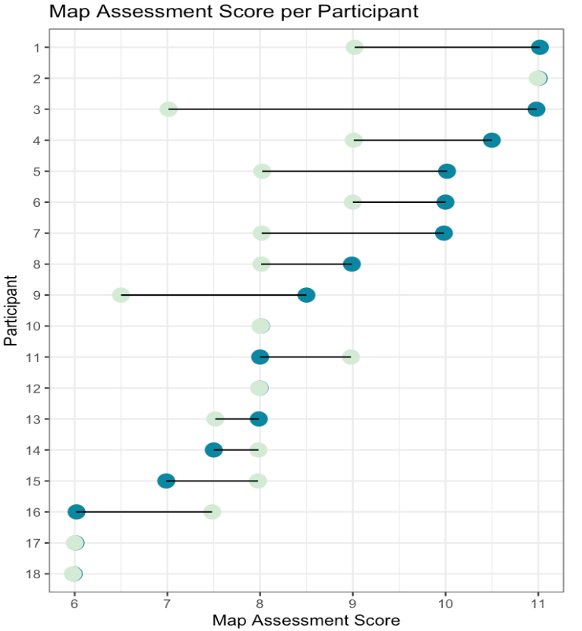
Assessment of ERC Workshops: Pilot Results

Slide 7
Next Steps and main takeaway
Rethink expectations of learning goals for one-off workshops
Conduct larger study to standardize the assessment tool (planned: 2 sections of Introduction to GIS methods in fall 2019, max n could = 50)

